Slide 1
Four studies of communicative, cognitive, and social factors in extremism and polarization
Matthew A. Turner
PhD Dissertation Defense
August 2, 2021
Chair: Paul E. Smaldino
Committee members: Teenie Matlock, Christopher T. Kello, and Jeffrey Yoshimi

Slide 2
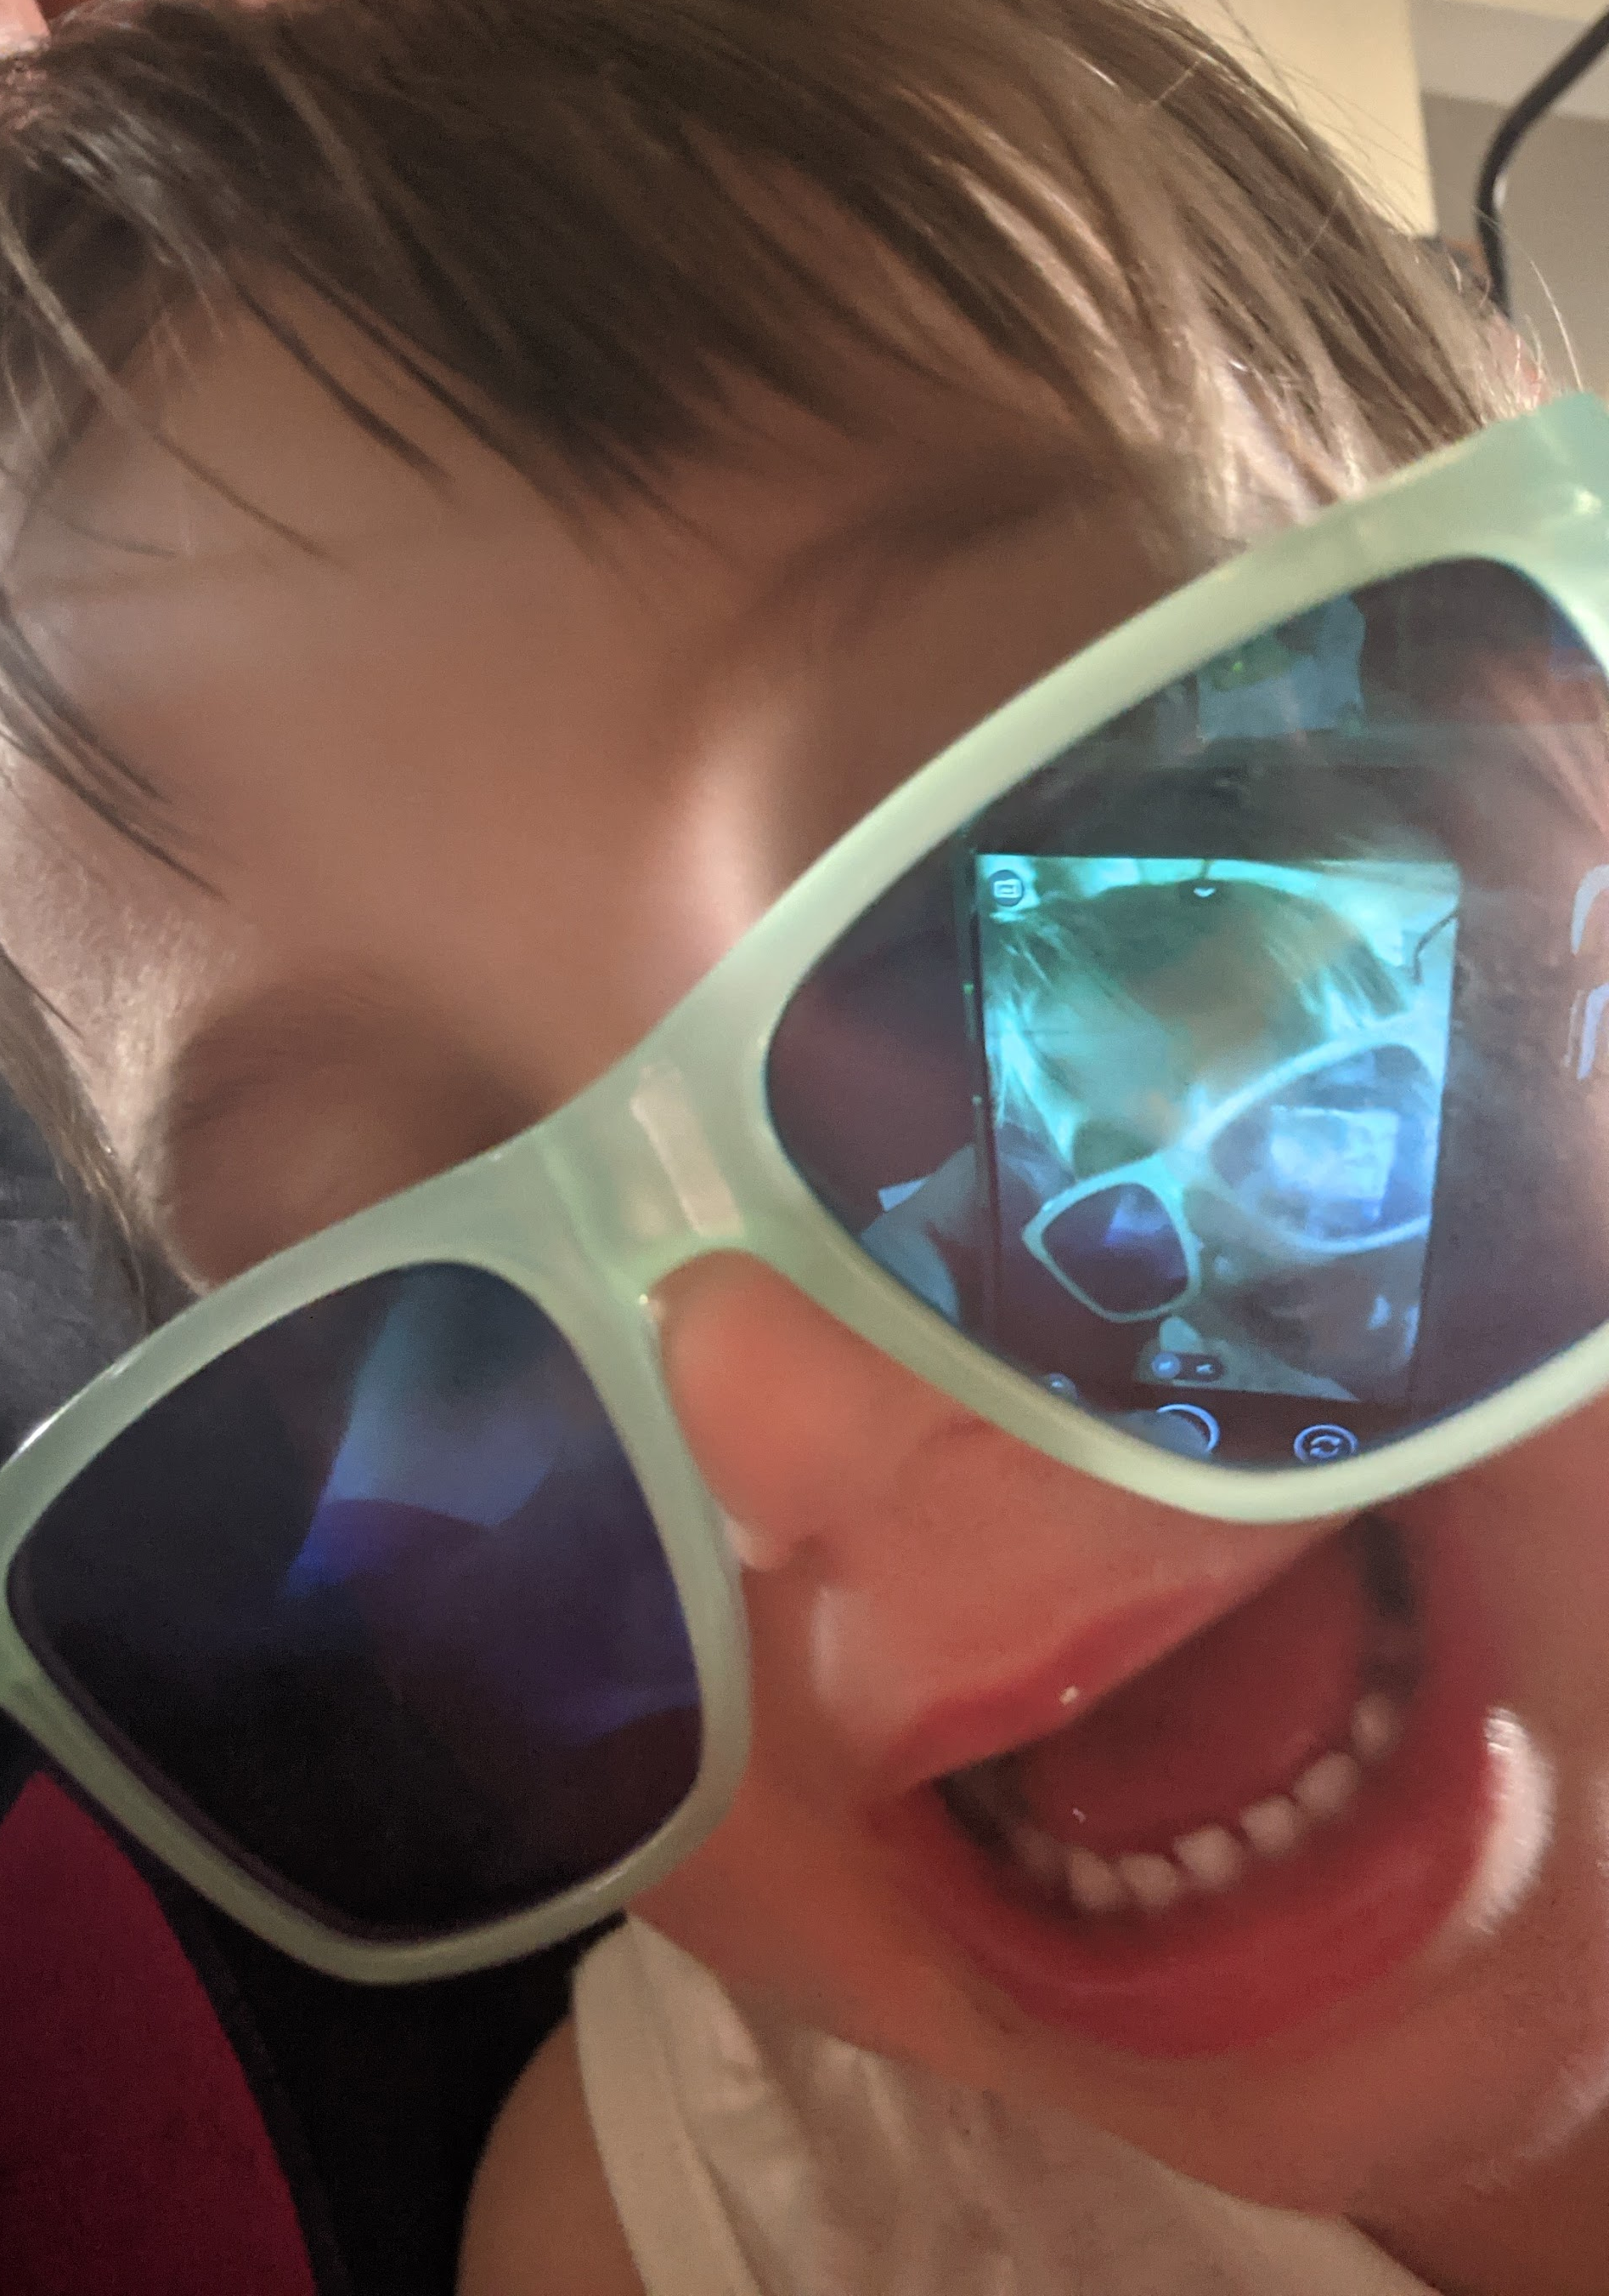
Dedicated to Phoebe Ruth “Oh, but why??”
Notes:
QUICK: Her favorite phrase right now is “oh, but why?” And I think that is inspirational for any scientist. And today we will be asking a few different “whys” about ... (next slide) the complex dynamical system of society and social influence.

Slide 3
Introduction The complex dynamical system of society and social influence.

Slide 4
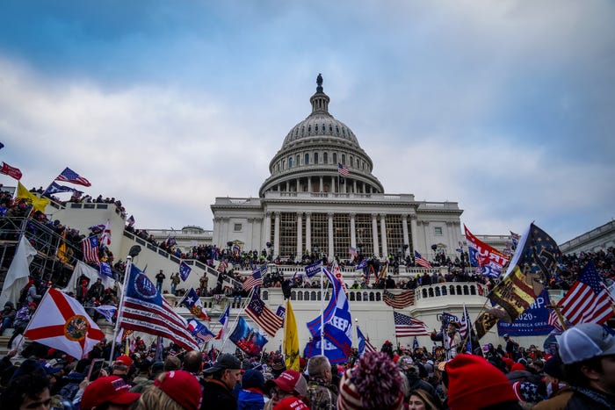
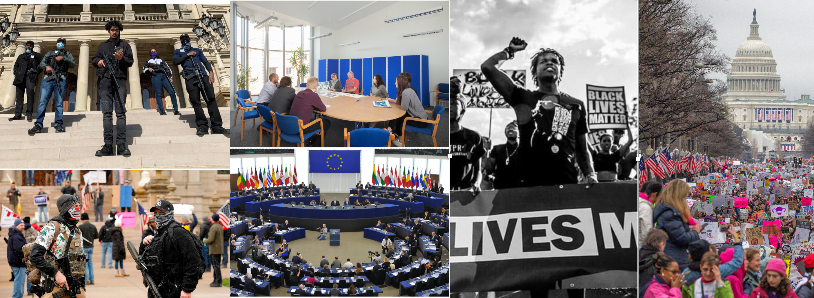
Polarization and extremism: Why do these collective social phenomena emerge and vary?

Slide 5
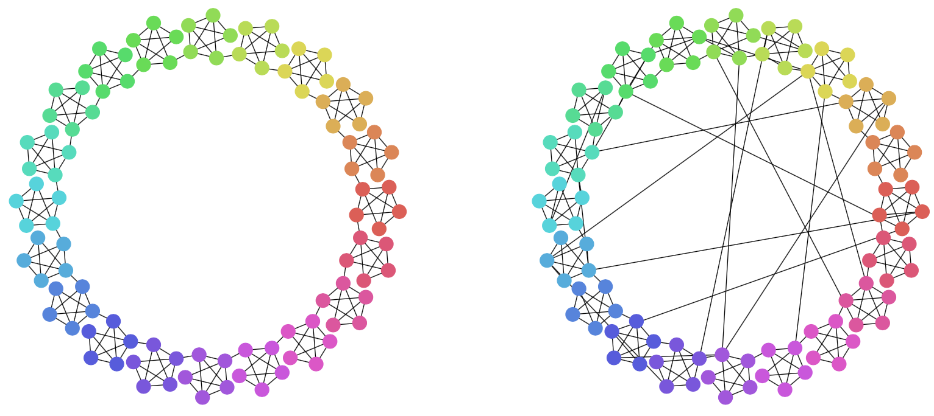
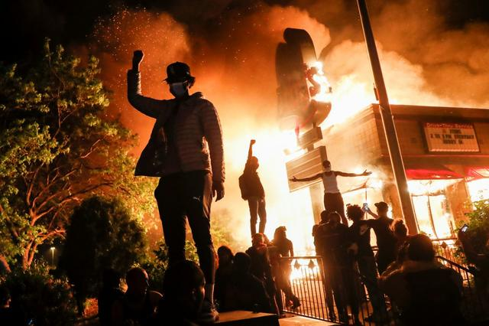
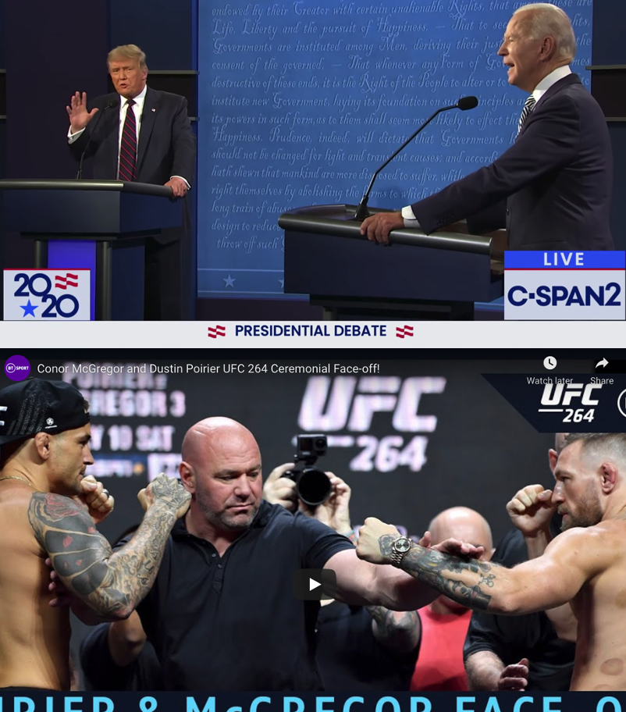
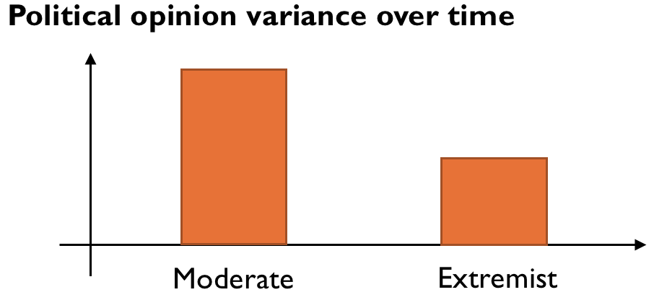
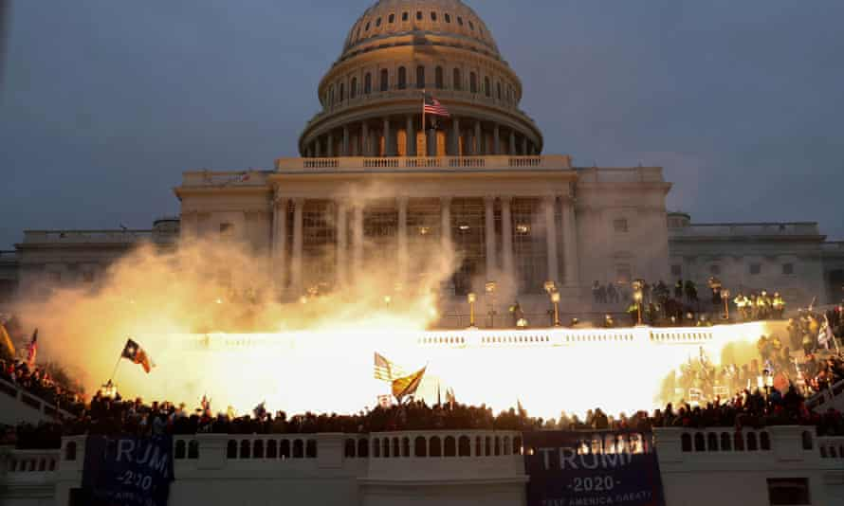
communicative, cognitive, and social factors...
Which
Stubborn extremists increase extremism
Interaction structure
and polarization
Metaphorical violence
in political discourse
Extremists are more “stubborn”
in-group
extremism
Social
network
(no
internet)
Social
network
(with
internet)
Increased
polarization?
... lead to increased extremism and polarization?
Notes:
Because systems of social influence that support extremism and polarization are complex, it is necessary to break them down into component parts and develop specific models to solve specific problems within each component. In my dissertation I worked to understand some communicative, cognitive and social factors in the emergence of extremism and polarization.

Slide 6
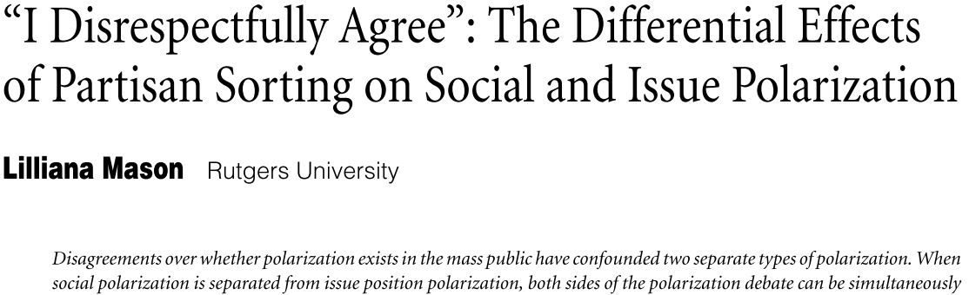
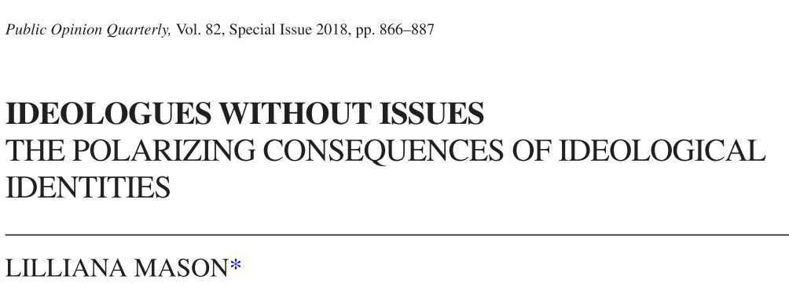
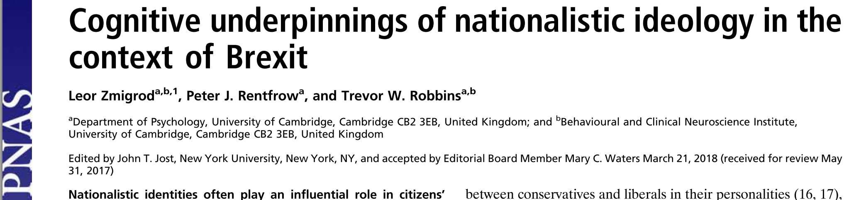
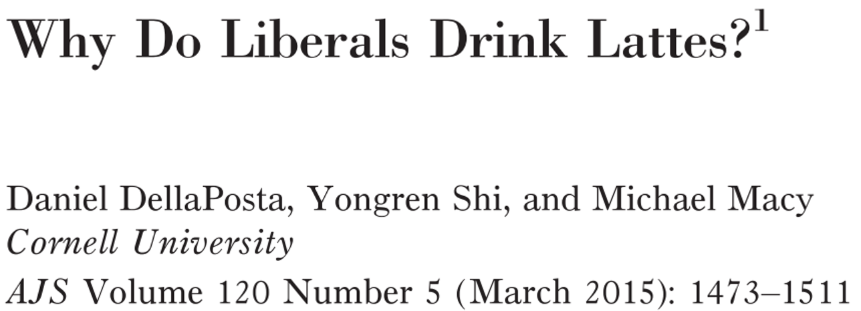


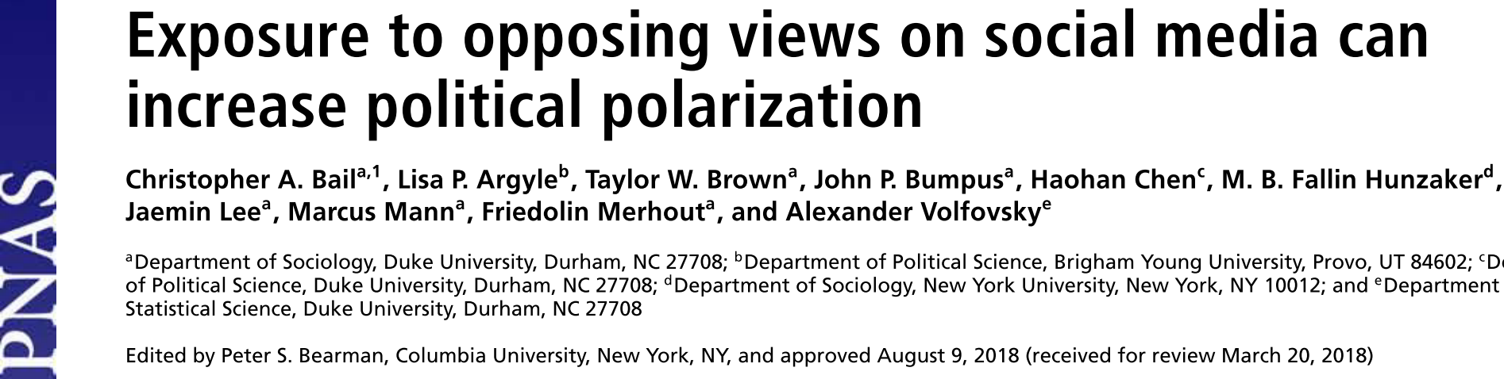
Evidence of extremism and polarization are often framed in partisan or issue-specific terms.
How can we understand extremism and polarization more generally and fundamentally, independent of partisanship and ideology?
Notes:
Mason one may be the one to end on because it’s very clear how the surveys connect to what I’m saying. For instance, on p. 873 Mason says she uses a four-point scale to measure ideological affect, e.g., “how willing would you be to marry a member of their own ideological group and the opposing ideological group (in randomized order). The responses included ‘I absolutely would not’, ‘I probably would not’, ‘I probably would’, ‘I absolutely would’, which were recoded to lie on a continuum between 0 and 1.
See also Mason (2015), “Measures” subsection in the Methods section, starting p. 132. → used in next slide
Here say something like “I want us to examine evidence for polarization a little more closely, specifically how polarization is typically framed in terms of partisan or issue-specific terms, and how we can generalize the idea of opinions, extremism, and polarization. This is necessary my dissertation focuses on understanding the general, context-independent communicative, cognitive, and social factors in extremism and polarization. Even in the empirical work on metaphor I will present, it is important to keep in mind that we are trying to understand how metaphorical violence affects people generally, not just partisans.”

Slide 7
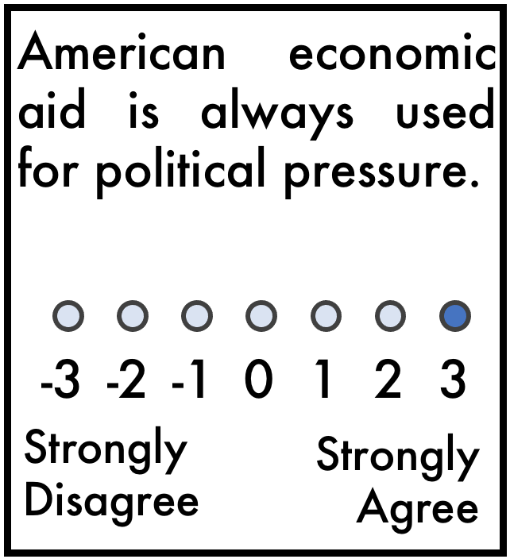
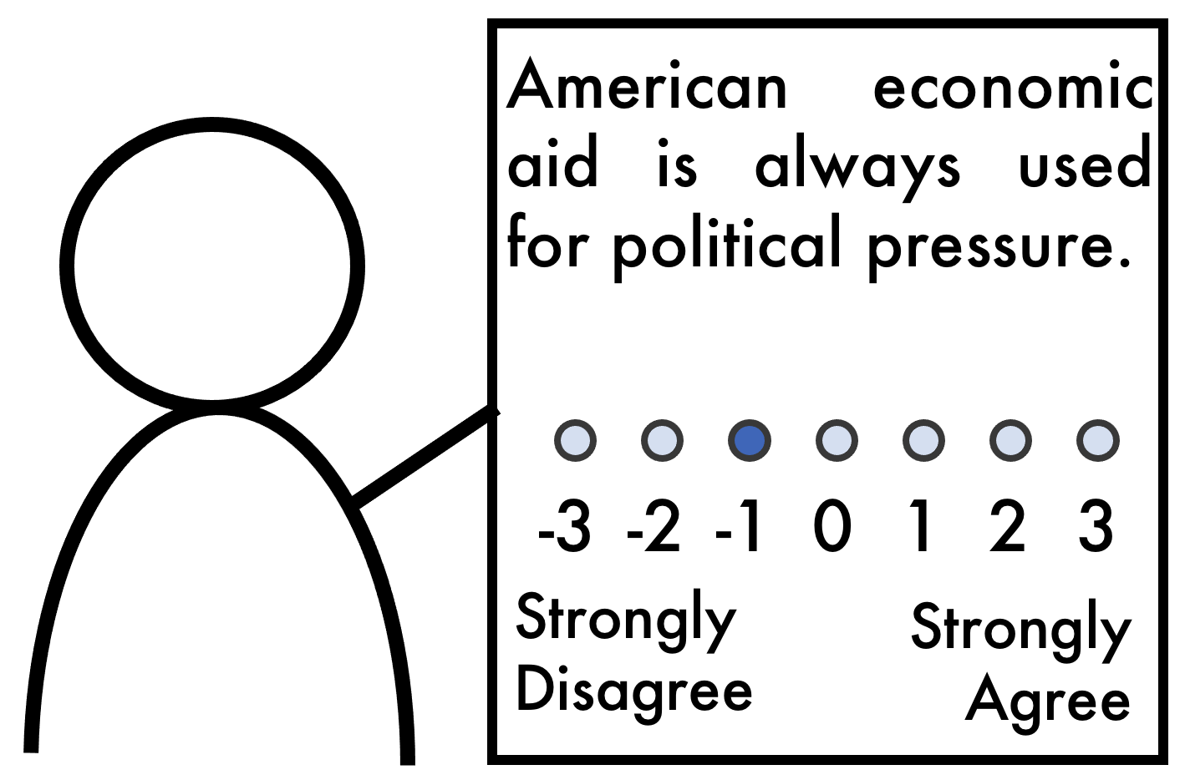
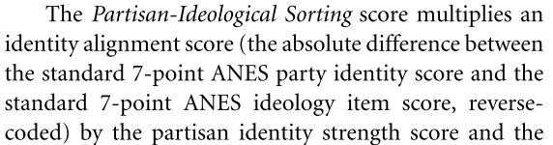
Implicit assumption: “latent” psychological opinions are continuous–often reported as ordinal numerical ratings.
I agree this much:
3.75
I disagree this much:
-1.25
ANES = American National Election Studies
(p. 132)
Mason, L. (2015). “I disrespectfully agree”: The differential effects of partisan sorting on social and issue polarization. American Journal of Political Science, 59(1), 128–145. https://doi.org/10.1111/ajps.12089

Slide 8
Polarization ≠ partisanship – a general distributional view of extremism and polarization.
Increased extremism as increased mean opinion magnitude.
Increased polarization as increased variance of opinion “distance” between dyads.

Slide 9
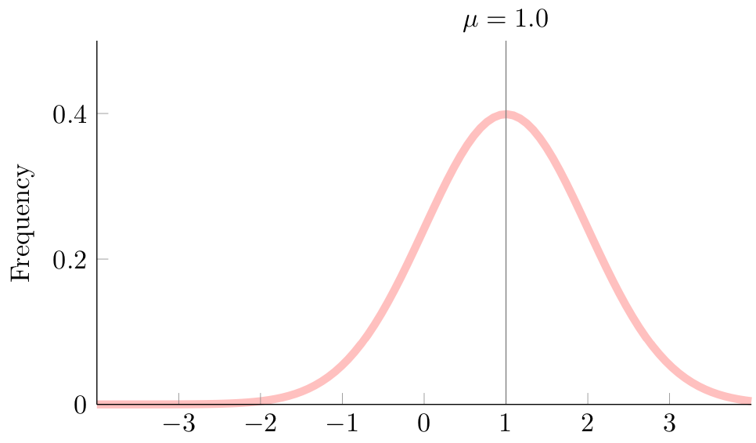
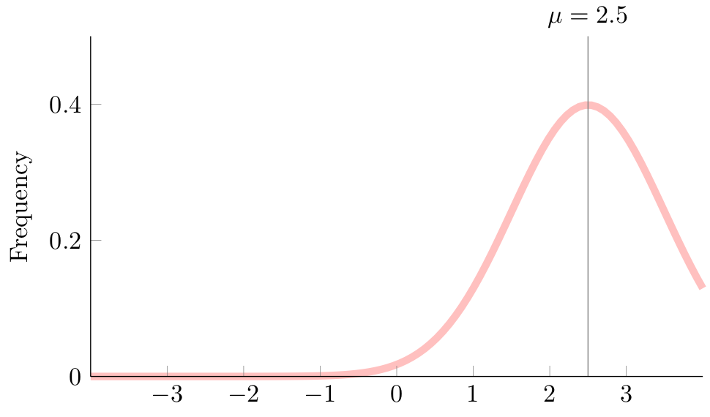
Increased extremism = increased mean opinion magnitude
Increased extremism
Opinion
Opinion

Slide 10
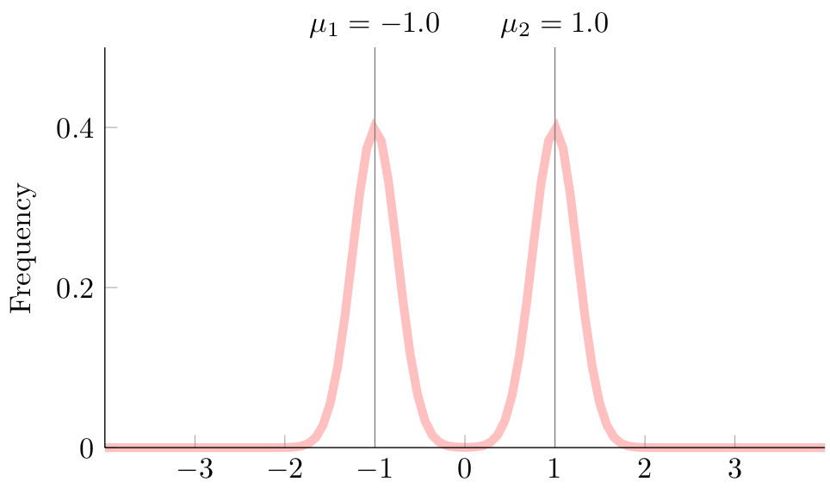
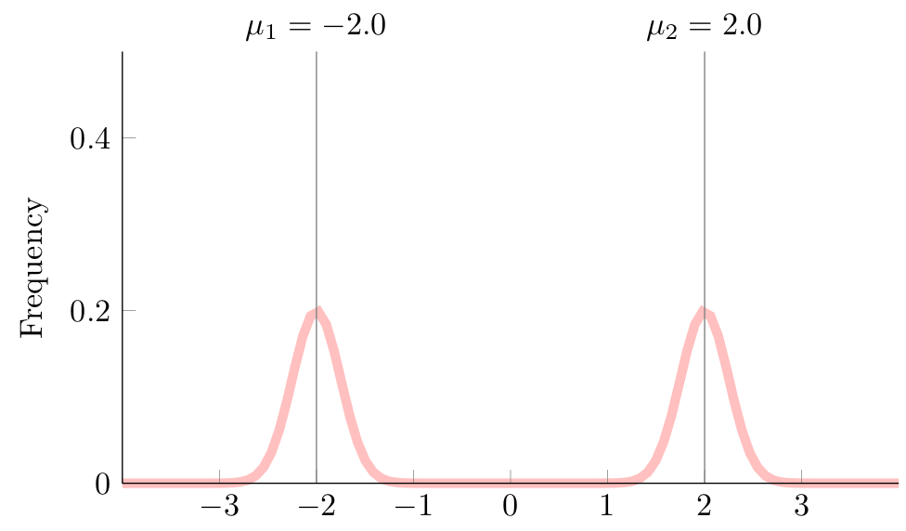
Increased polarization = increased pairwise opinion distance
Increased polarization
Opinion
Opinion

Slide 11
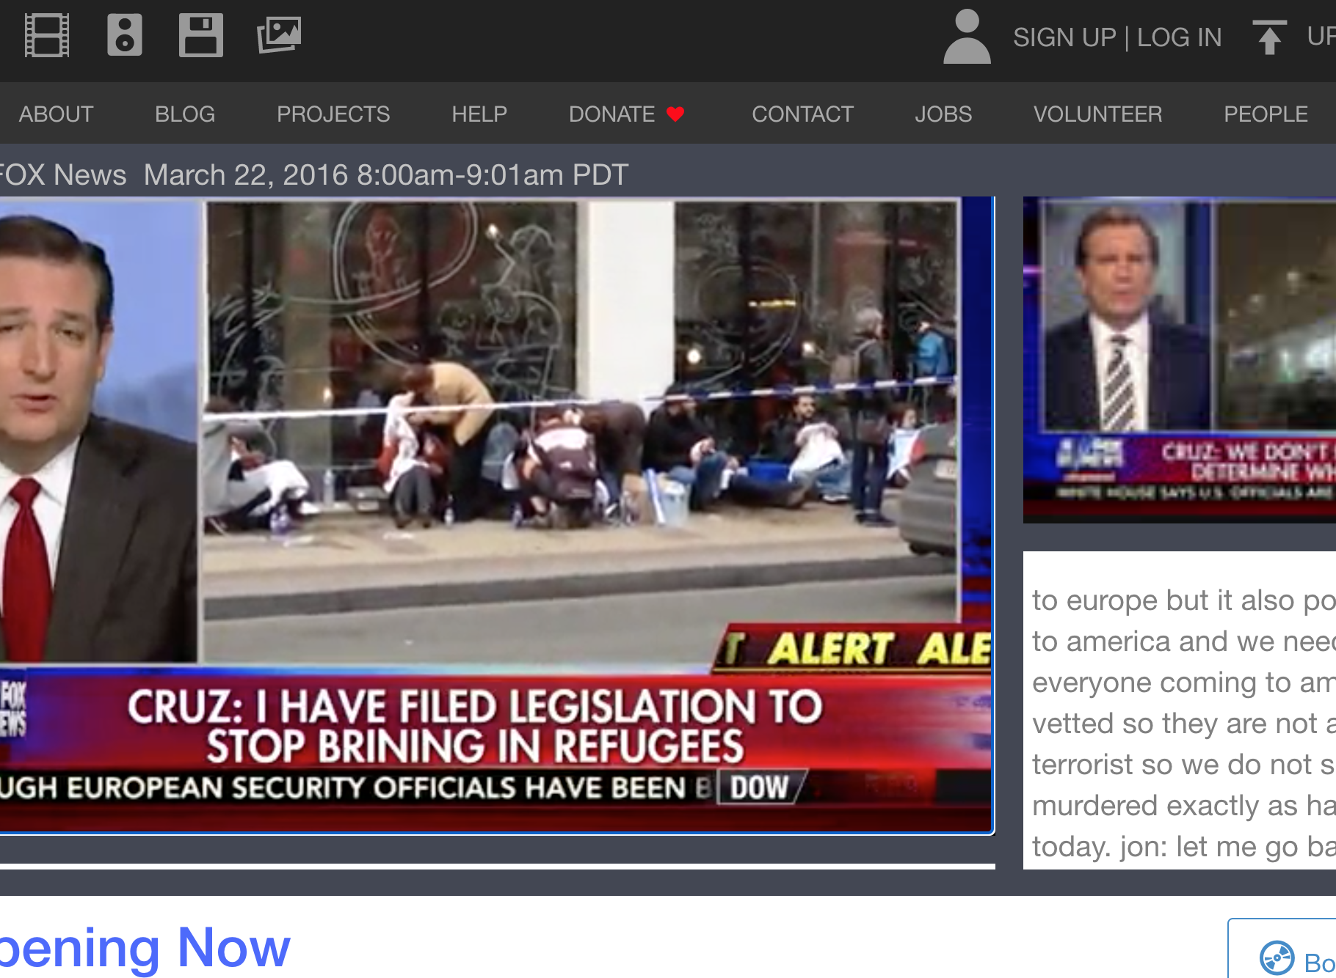
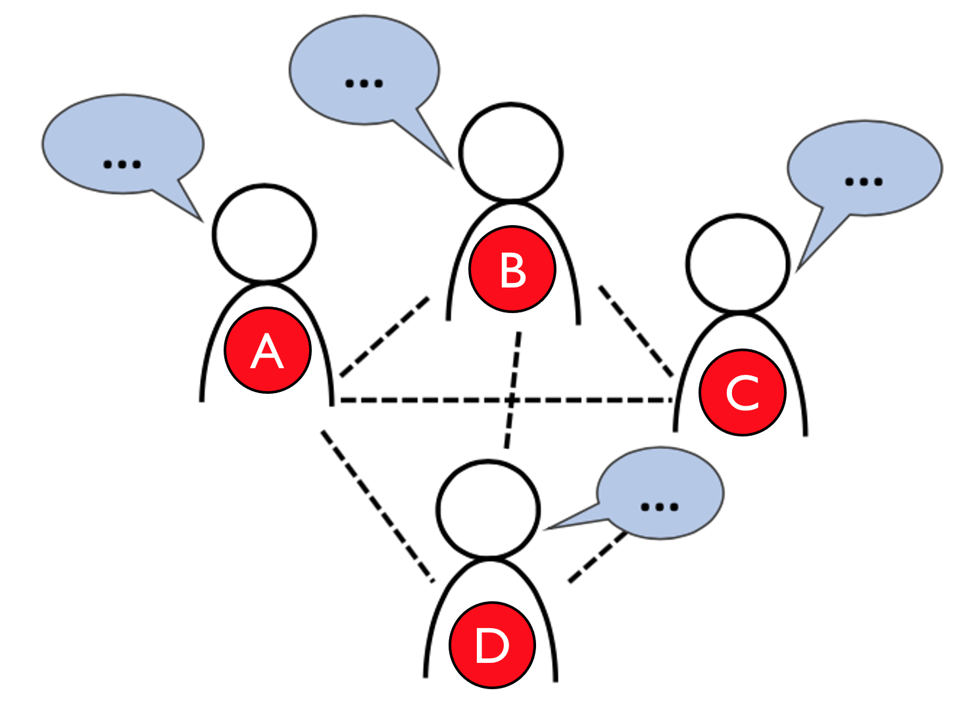
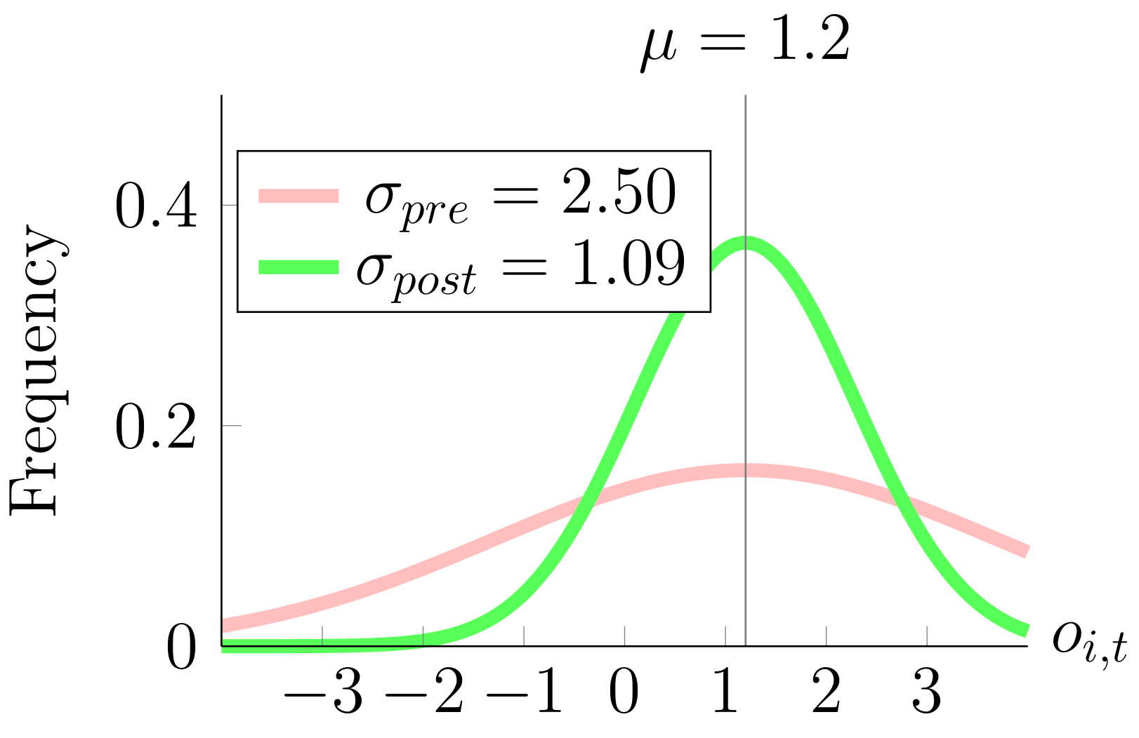
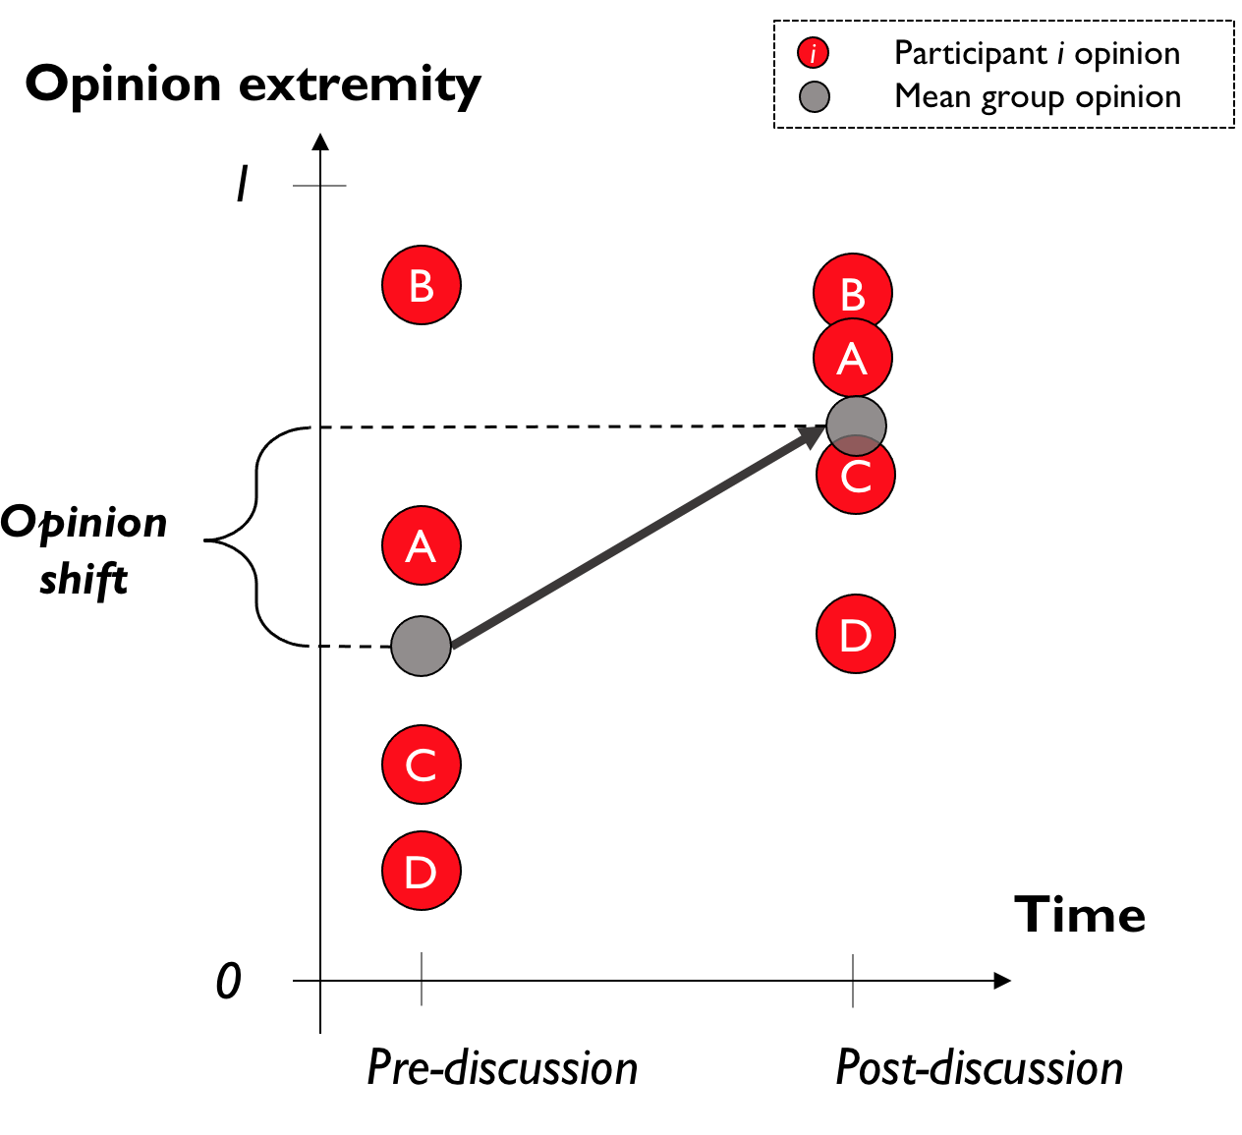
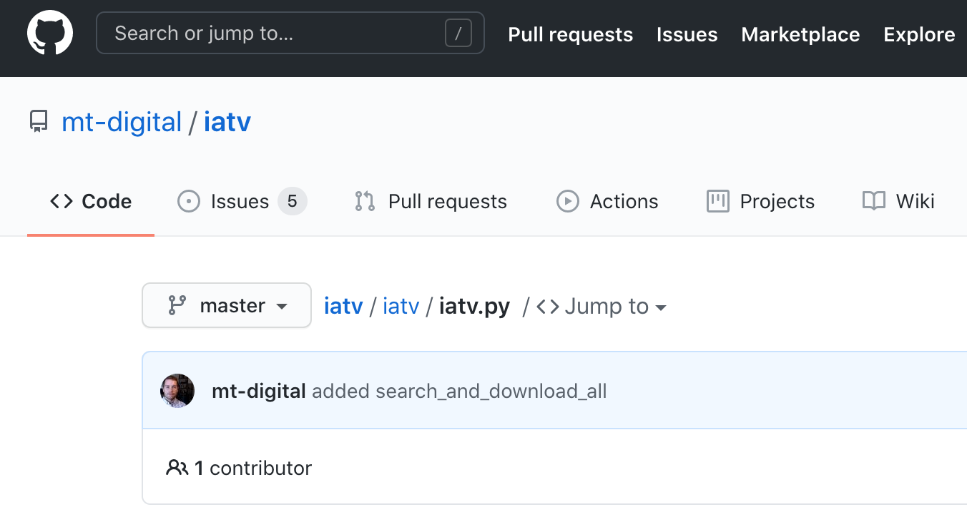
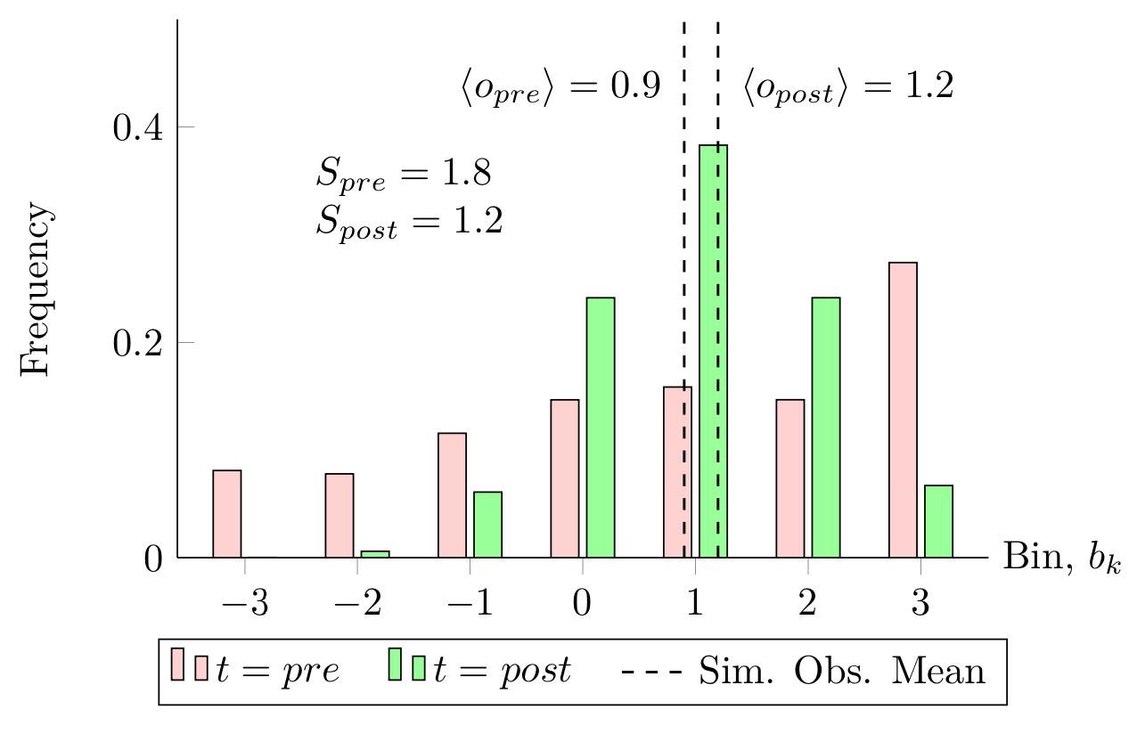
Computational methods
Statistical modeling of TV
News Archive and Twitter data
Agent-based models of social
influence in experiments
and society
Statistical simulations of
“group polarization” experiments
Step 1: Opinion distribution
Step 2: Simulated measurement

Slide 12
Study 1 Dynamics and determinants of metaphorical violence on US cable TV news. Violence metaphors can lead to violence & polarization—but what leads to violence metaphors?

Slide 13

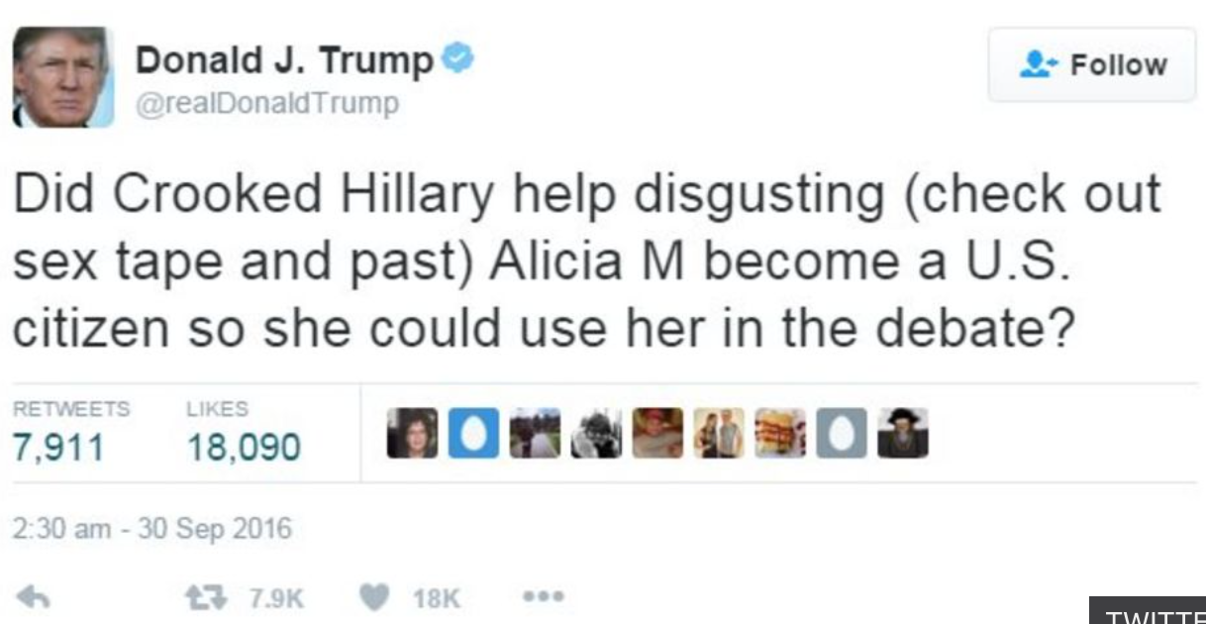
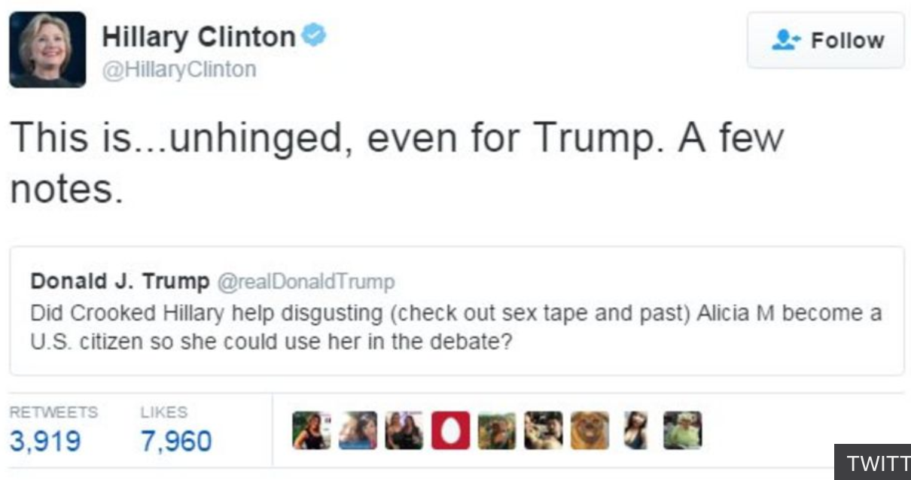
Communicative factors: metaphorical violence
Joe Biden in first 2020 debate (referring to Bernie Sanders): “I beat him a whole hell of a lot.”
Fox News Anchor Megyn Kelly discussing 2016 debate strategy: “You (say Clinton) should get in his face...put him in the pain locker and shake it around. You think she should attack, attack, attack.”
MSNBC guest host Kate Baldwin discussing 2016 cycle: “﻿Tonight, Hillary Clinton hammering Donald Trump for his attacks on former Miss Universe Alicia Machado.”

Slide 14
Metaphorical violence use on US cable TV news?
What is the distribution of metaphorical violence in real world discourse?
What cultural events affect metaphorical violence use in real world discourse?
Specifically, does metaphorical violence use increase around the time of the US presidential debates and elections?
What else could affect the frequency of metaphorical violence use?
Notes:
But to answer these questions we need to understand a bit more about how metaphor works and how it increases extremism and polarization in the real world.

Slide 15
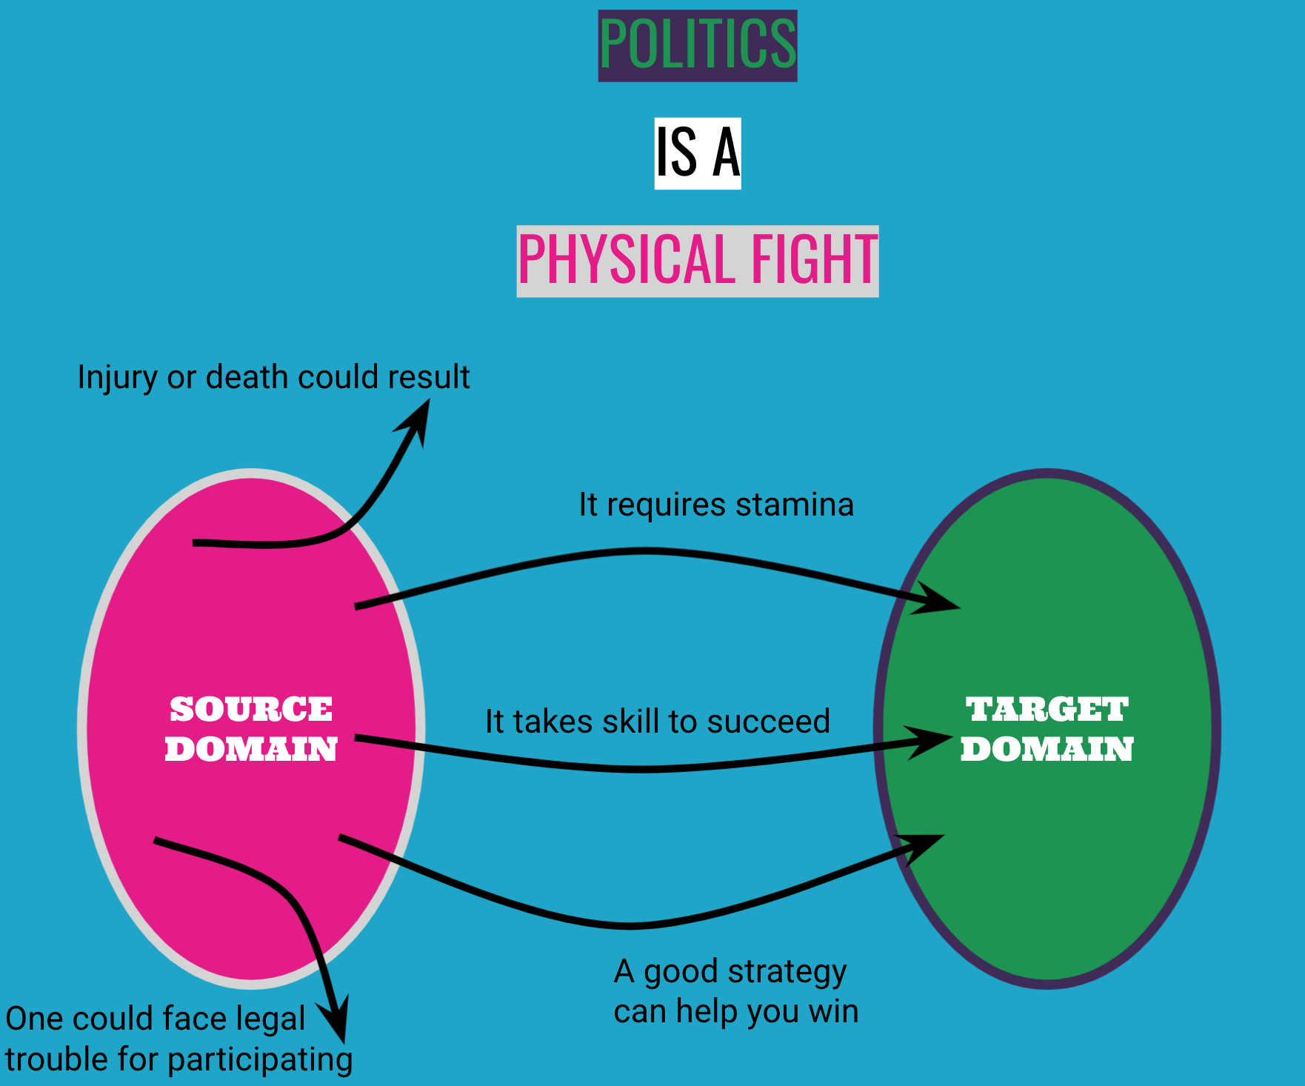
Metaphor maps concepts from one domain onto another.
Lakoff, G., & Johnson, M. (1980). Metaphors We Live By. Chicago: University of Chicago Press.
Gibbs, R. W. (2017). Metaphor Wars. Cambridge University Press.

Slide 16
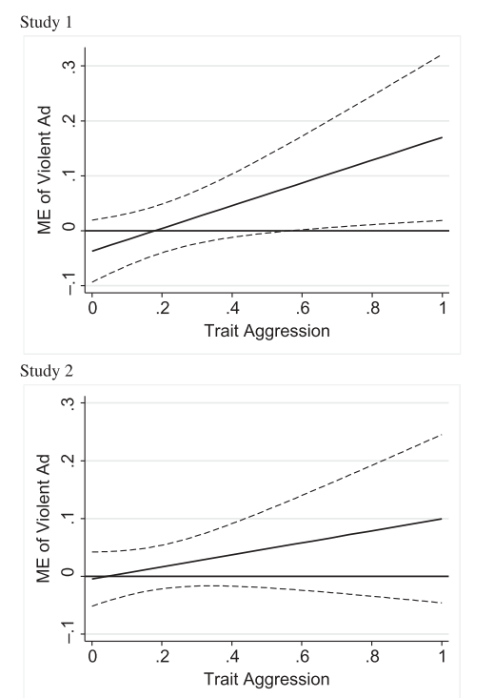
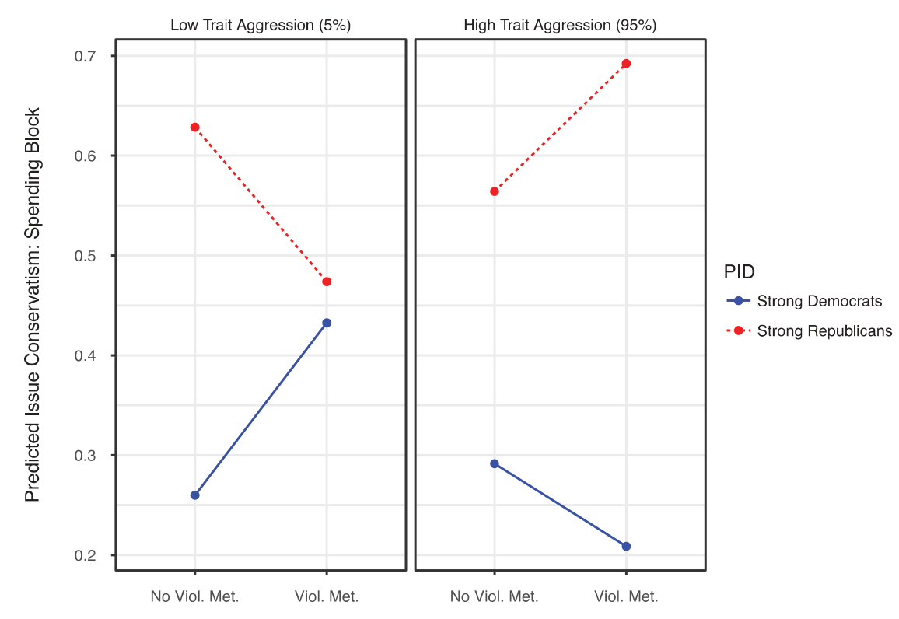
Violence metaphors have real-world effects, modulated by personality trait aggression.
Kalmoe, N. P. (2014). Fueling the fire: Violent metaphors, trait aggression, and support for political violence. Political Communication, 31(4), 545–563.
Kalmoe, N. P., Gubler, J. R., & Wood, D. A. (2018). Toward Conflict or Compromise? How Violent Metaphors Polarize Partisan Issue Attitudes. Political Communication, 35(3), 333–352.
Increase in support
for political violence
Conservatism rating following viol. met. exposure
Increase in support
for political violence
Exposure to violence metaphors
Notes:
TODO: NEED TO IMPROVE AXES LABELS HERE.

Slide 17
Metaphorical violence use on US cable TV news?
What is the distribution of metaphorical violence in real world discourse?
What cultural events affect metaphorical violence use in real world discourse?
Specifically, does metaphorical violence use increase around the time of the US presidential debates and elections?
What else could affect the frequency of metaphorical violence use?

Slide 18
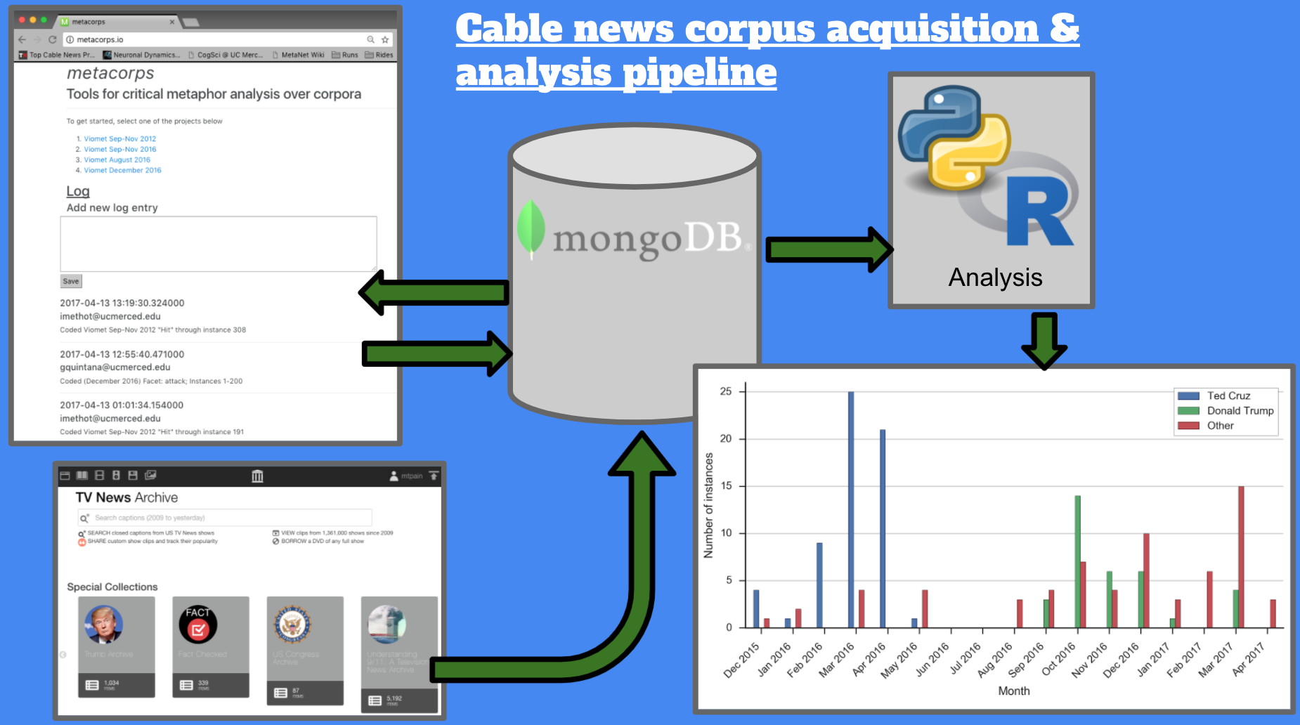
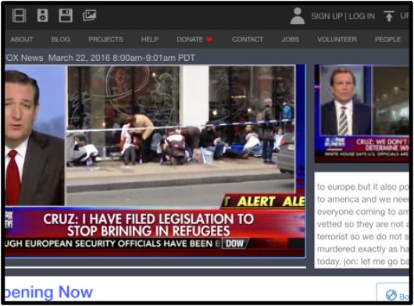
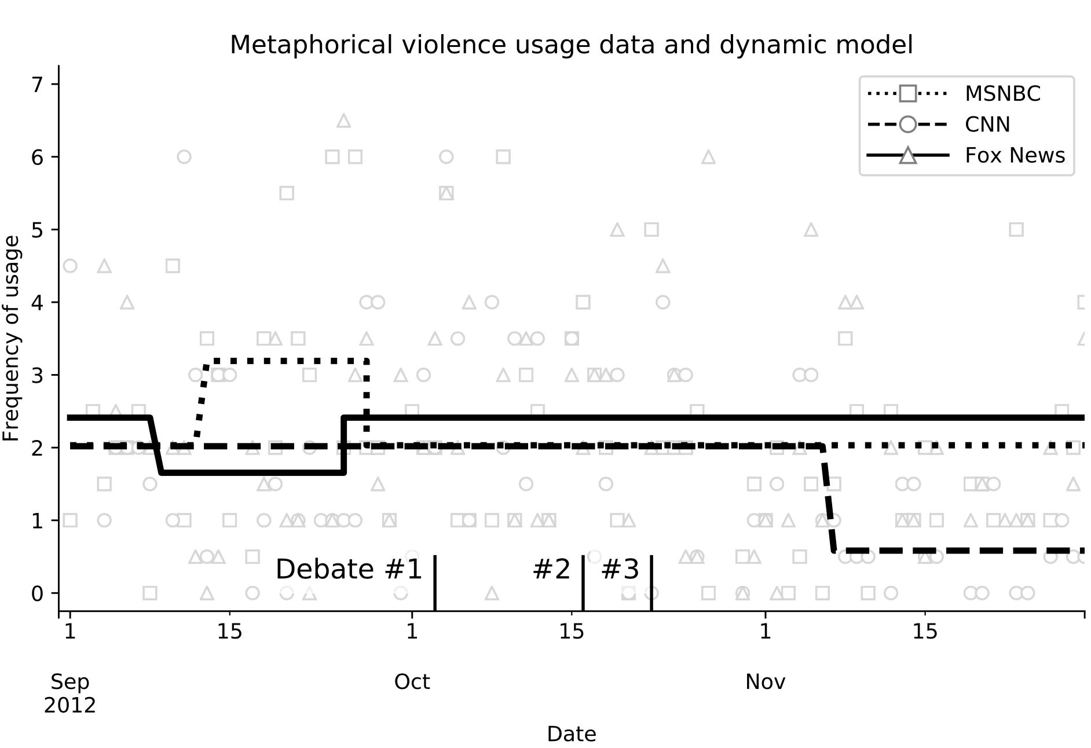
TV News Archive Data Ingestion and Annotation
Collected and analyzed transcripts from 6 top-rated shows on MSNBC, CNN, and Fox news
Considered violent words attack, hit, and beat.
Time frame: September 1 – December 1, 2012 & 2016
Content: METHODS
Data source & ingestion
Data processing/annotation
Statistical procedures for dynamic model fitting and correlational analysis

Slide 19
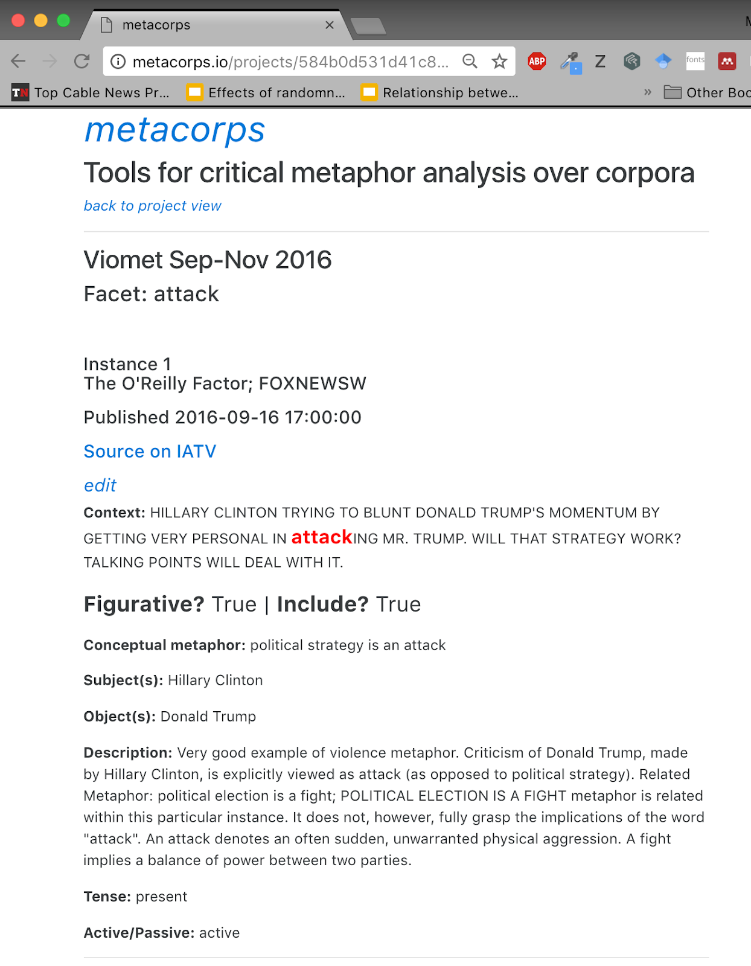

TV News Archive Data Ingestion and Annotation
Collected and analyzed transcripts from 6 top-rated shows on MSNBC, CNN, and Fox news
Considered violent words attack, hit, and beat.
Time frame: September 1 – December 1, 2012 & 2016

Slide 20
Statistics for calculating reaction to cultural events
1. Reaction to presidential debates and elections
2. Reaction to presidential Twitter use
Test various partitions of the data into “normal” and “excited” states, which creates a step function model of the daily metaphor usage data.
The partition that maximizes the likelihood function of the fit is the best model for the data.
Calculate the correlation between data columns:
Daily counts of metaphorical violence use across various dimensional cross-sections.
The number of times a candidate’s Twitter account (e.g., @realDonaldTrump, @HillaryClinton in 2016)
Content: METHODS
Data source & ingestion
Data processing/annotation
Statistical procedures for dynamic model fitting and correlational analysis

Slide 21
Statistics for calculating reaction to cultural events
1. Reaction to presidential debates and elections
2. Reaction to presidential Twitter use
Test various partitions of the data into “normal” and “excited” states, which creates a step function model of the daily metaphor usage data.
The partition that maximizes the likelihood function of the fit is the best model for the data.
Calculate the correlation between data columns:
Daily counts of metaphorical violence use across various dimensional cross-sections.
The number of times a candidate’s Twitter account (e.g., @realDonaldTrump, @HillaryClinton in 2016)
Content: METHODS
Data source & ingestion
Data processing/annotation
Statistical procedures for dynamic model fitting and correlational analysis

Slide 22
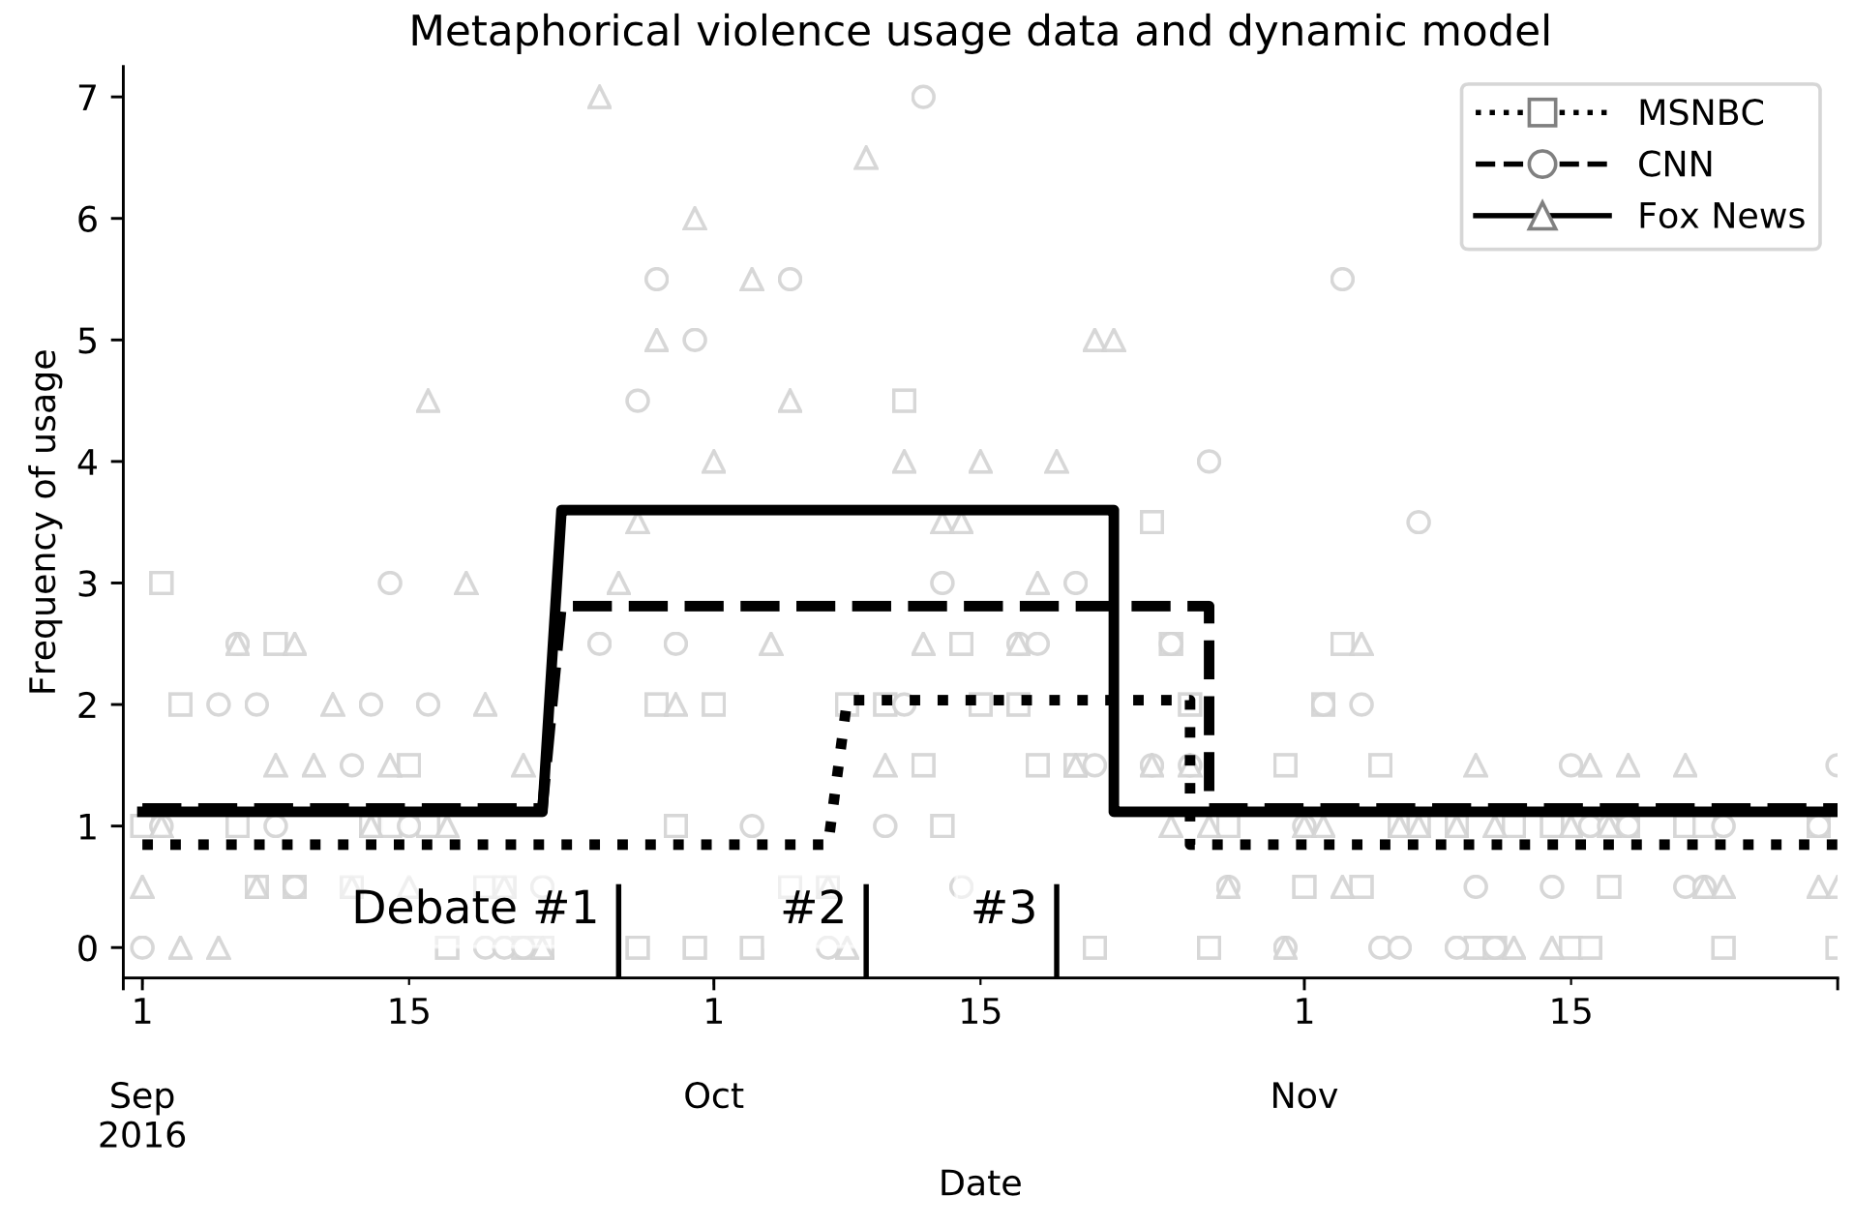
Metaphorical violence on cable news
September 1 – December 1,
2012
September 1 – December 1,
2016

Slide 23
Statistics for calculating reaction to cultural events
1. Reaction to presidential debates and elections
2. Reaction to presidential Twitter use
Test various partitions of the data into “normal” and “excited” states, which creates a step function model of the daily metaphor usage data.
The partition that maximizes the likelihood function of the fit is the best model for the data.
Calculate the correlation between data columns:
Daily counts of metaphorical violence use across various dimensional cross-sections.
The number of times a candidate’s Twitter account (e.g., @realDonaldTrump, @HillaryClinton in 2016)
Content: METHODS
Data source & ingestion
Data processing/annotation
Statistical procedures for dynamic model fitting and correlational analysis

Slide 24
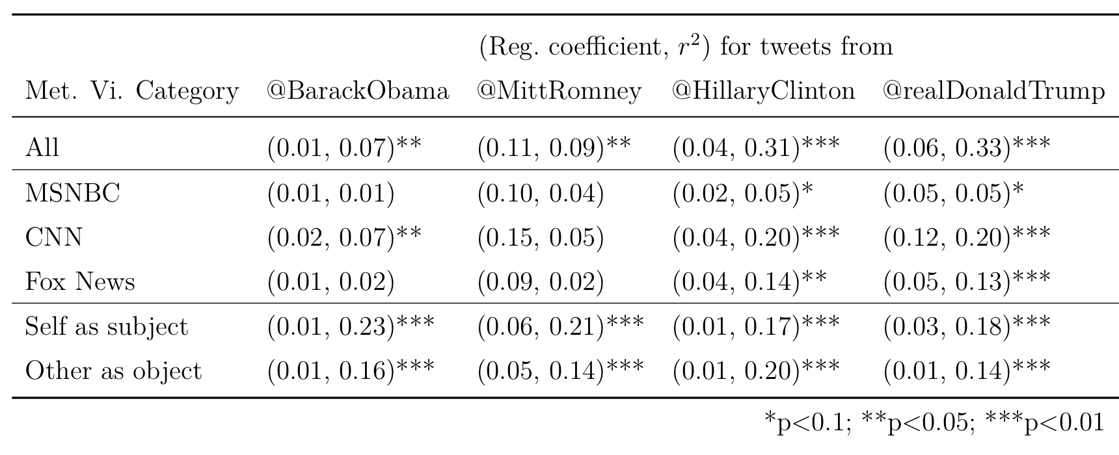
Metaphorical violence is correlated with candidate tweets
September 1 – December 1,
2012
September 1 – December 1,
2016
2016 was more reactive overall with more significant correlations (lower p-value) and more variance explained by either candidate tweeting.
Notes:
Make multiple slides to animate this table with boxes over important information and write out the point you want to make with each box.

Slide 25
Metaphorical violence is correlated with candidate tweets
September 1 – December 1,
2012
September 1 – December 1,
2016
2016 was more reactive across networks, with CNN being the most reactive to presidential Tweets in both years.
Notes:
Make multiple slides to animate this table with boxes over important information and write out the point you want to make with each box.

Slide 26
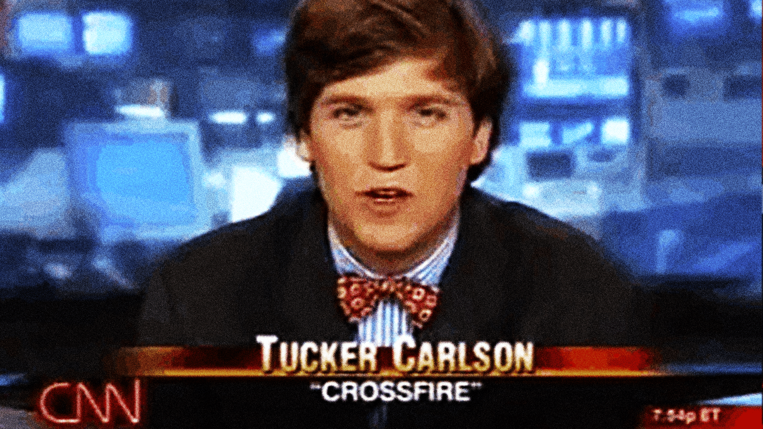
Metaphorical violence is correlated with candidate tweets
September 1 – December 1,
2012
September 1 – December 1,
2016
2016 was more reactive across networks, with CNN being the most reactive to presidential Tweets in both years.
Taibbi, M. (2019). Hate, Inc: Why today’s media makes us despise one another. OR Books.
Notes:
Not surprising actually, given CNN’s pioneering show “Crossfire” which merged professional wrestling at one point featuring conservative Tucker Carlson as the tough guy and liberal Paul Begala as the pretty boy. Note the

Slide 27
Study 1 Conclusion: Metaphorical violence responded more to cultural events in 2016 than 2012, driven by Twitter use by the candidates. Further evidence that metaphorical violence responds to and shapes our understanding of cultural events.
Kövecses, Z. (2010). Metaphor, language and culture. Delta, 26, 739–757.

Slide 28
Study 2 Group polarization* emerges from stubborn extremism.
(and 3)
Or does it?
*Group polarization = increased extremism in socially isolated groups of study participants.

Slide 29
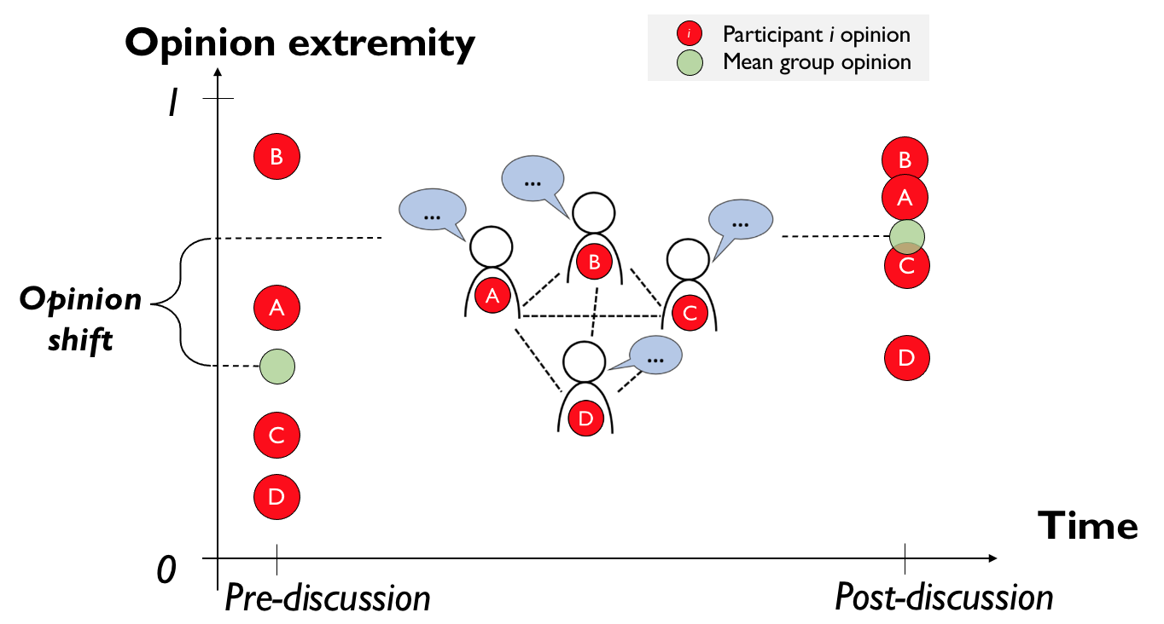
Study 2: Is there a more parsimonious way to explain group polarization and, ideally, the correlation between initial extremism and opinion shift?
Opinion shift
Single experiment
Trend
Initial average
group extremity

Slide 30
Group polarization opinion shift: extreme consensus
Opinion extremity
Participant i opinion
Mean group opinion
i
1
B
B
A
C
Opinion shift
A
D
C
D
Time
0
Pre-discussion
Post-discussion
*Group polarization = increased extremism in socially isolated groups of study participants.

Slide 31
Decades of evidence for group polarization.
“[S]everal hundred studies” have supported the reality of group polarization, according to Rupert Brown in his 2000 book Group Processes (p. 198).
Cass Sunstein (2002) elevated group polarization to a scientific law in his paper “The Law of Group Polarization” in The Journal of Political Philosophy.
Sunstein worked in the Obama White House as Administrator of the Office of Information and Regulatory Affairs, the “regulatory czar”

Slide 32
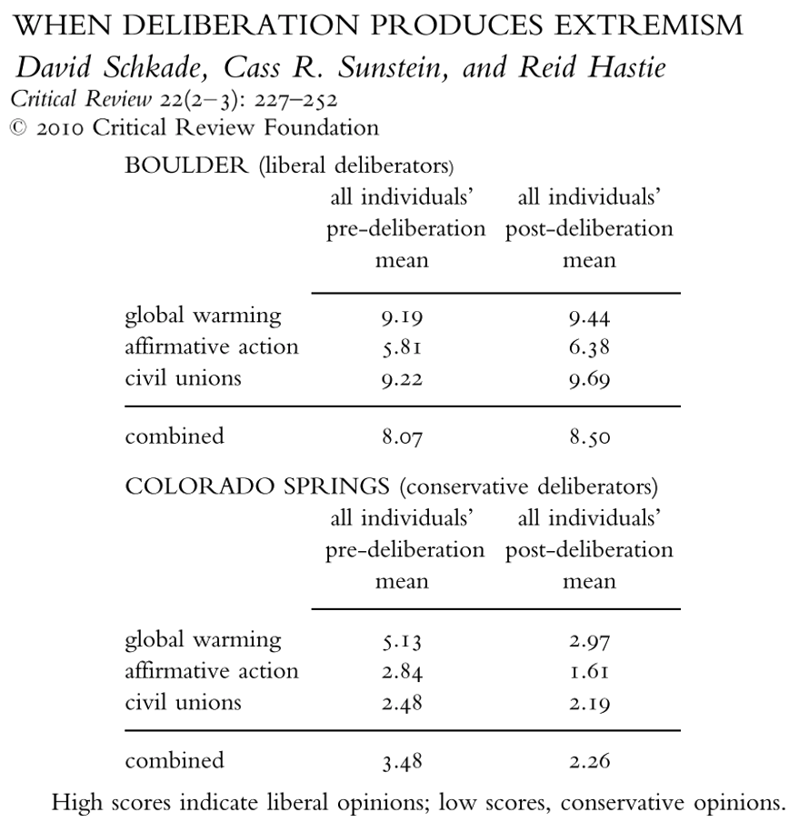
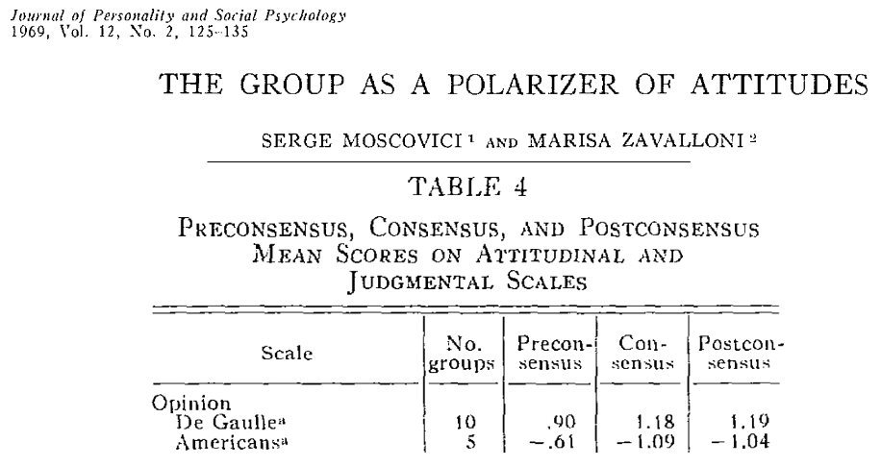
Decades of evidence for group polarization.

Slide 33
Empirical pattern: initial extremity predicts size of opinion shift
Teger, A. I., & Pruitt, D. G. (1967). Components of group risk taking. Journal of Experimental Social Psychology, 3(2), 189–205.
Myers, D. G., & Arenson, S. J. (1972). Enhancement of Dominant Risk Tendencies in Group Discussion. Psychological Reports, 30(2), 615–623.
Single experiment
Trend
Opinion shift
Initial average
group extremity
Notes:
Add text to explain the value of stubborn extremism model. Other models do not explain this aspect.

Slide 34
Existing explanations of group polarization
1. Social comparisons
2. Persuasive arguments
People tend to underestimate the extremity of the group norm of what the socially appropriate opinion is.
Group polarization occurs because the average participant realizes the norm is more extreme, they too become more extreme.
Social influence occurs through the exchange of discrete “arguments” that do not change during discussion.
Group polarization happens because extremists know and use more arguments than moderates.
3. Self-categorization
4. Social decision schemes
Participants are driven by desire to fit in to in-group, so they adjust their opinions in relation to an imagined out-group.
To do this people calculate a “meta-contrast ratio” and change their opinions to match that ratio.
Participants are assumed to be one of a small set of problem solvers.
Groups assumed to have a collective strategy for problem solving.
Group polarization occurs because the group “social decision scheme” tends to weight extremist opinions more.
Notes:
Could superimpose “problematic assumptions” in red over each alternative to explain how it is lacking. Is here where to explain how our model is more parsimonious?
(e.g., can find solution, can recognize solution, cannot recognize or find a solution)
Groups are assumed to have a scheme for decision making (e.g., all must independently find solution, a majority must find or recognize solution, etc.)

Slide 35
Existing explanations of group polarization
1. Social comparisons
2. Persuasive arguments
People tend to underestimate the extremity of the group norm of what the socially appropriate opinion is.
Group polarization occurs because the average participant realizes the norm is more extreme, they too become more extreme.
Social influence occurs through the exchange of discrete “arguments” that do not change during discussion.
Group polarization happens because extremists know and use more arguments than moderates.
Where do norms come from in the first place, and how do participants infer them?
What makes an argument persuasive? How does one argue for a centrist opinion?
3. Self-categorization
4. Social decision schemes
Participants are driven by desire to fit in to in-group, so they adjust their opinions in relation to an imagined out-group.
To do this people calculate a “meta-contrast ratio” and change their opinions to match that ratio.
Participants are assumed to be one of a small set of problem solvers.
Groups assumed to have a collective strategy for problem solving.
Group polarization occurs because the group “social decision scheme” favors
Where do group decision schemes come from in the first place? How do, e.g., political opinions connect with problem solving?
How is the meta-contrast ratio calculated in the brain?
Notes:
Could superimpose “problematic assumptions” in red over each alternative to explain how it is lacking. Is here where to explain how our model is more parsimonious?
(e.g., can find solution, can recognize solution, cannot recognize or find a solution)
Groups are assumed to have a scheme for decision making (e.g., all must independently find solution, a majority must find or recognize solution, etc.)

Slide 36
Decades of evidence for group polarization, four enduring theoretical explanations.
Again, from Brown’s Group Processes (2002, p. 212):
“We are left, then, with the theoretically inelegant but nevertheless probably correct conclusion that all [four] types of processes are present to some degree in most decision-making situations in the real world.”
Not good enough!
When and why are different pathways to group polarization active? Can we really understand group polarization with the current explanations?
Notes:
“Probably!” I think we can do better than inelegance and hand-waving statements about what “probably” happens. We can do better. Moving forward, we should want to know when and why

Slide 37
Is there a more parsimonious way to explain group polarization and, ideally, the correlation between initial extremism and opinion shift?
Opinion shift
Single experiment
Trend
Initial average
group extremity

Slide 38
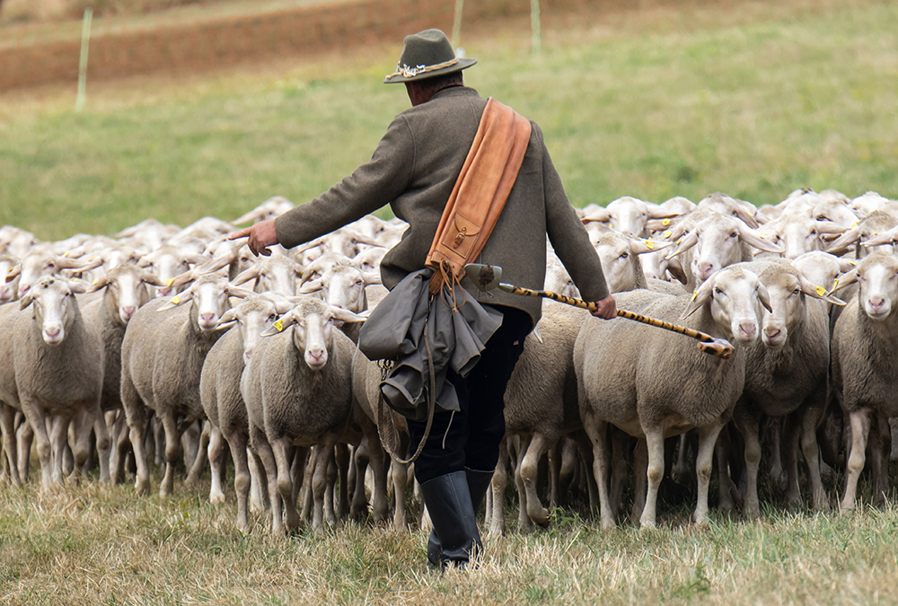
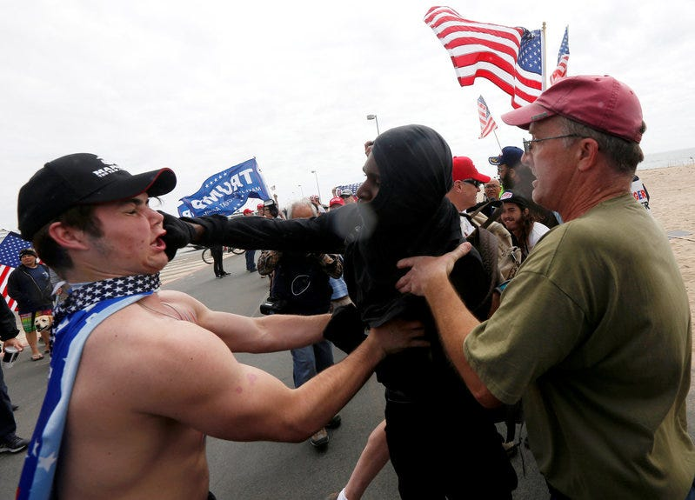
Cognitive capacities and properties for social influence
1. Consensus and conformity
2. Repulsive influence
Asch, S. E. (1956). Studies of Independence and Conformity. Psychological
Monographs: General and Applied, 70(9).
Bail, C. A., et al., (2018). Exposure to opposing views on social media can increase political
polarization. PNAS, 115(37), 9216–9221.
3. Stubborn extremism
Susceptibility to social influence
Moderate
Extremist
Notes:
Stubborn extremism is bolded because I demonstrate that this assumption, when included in a computational model of social influence, leads to the emergence of a phenomenon known as group polarization. Group polarization is the name given to the experimental observation that socially isolated groups tend to become more extreme over time, which I will explain in more detail later.

Slide 39
Cognitive capacities and properties for social influence
1. Consensus and conformity
2. Repulsive influence
3. Stubborn extremism
4. Preference for similar others
Susceptibility to social influence
Moderate
Extremist
Notes:
Stubborn extremism is bolded because I demonstrate that this assumption, when included in a computational model of social influence, leads to the emergence of a phenomenon known as group polarization. Group polarization is the name given to the experimental observation that socially isolated groups tend to become more extreme over time, which I will explain in more detail later.

Slide 40
Evidence for stubborn extremism
Participants with more extreme attitudes (i.e., opinions) show weaker event-related potential responses to perceptual anomalies¹.
Participant performance on a “cognitive flexibility” task (e.g., Wisconsin card sorting task) was inversely correlated with opinion extremity².
Moderates show more variance associated with question framing and question order than extremists when answering survey questions; moderates have more inconsistent opinions in general over time³.
Reiss, S., Klackl, J., Proulx, T., & Jonas, E. (2019). Strength of socio-political attitudes moderates electrophysiological responses to perceptual anomalies. PLoS ONE, 14(8), 1–17.
Zmigrod, L., Rentfrow, P. J., & Robbins, T. W. (2019). Cognitive inflexibility predicts extremist attitudes. Frontiers in Psychology, 10(MAY), 1–13.
Kinder, D. R., & Kalmoe, N. P. (2017). Neither Liberal nor Conservative. Chicago: University of Chicago Press.

Slide 41
Stubborn extremism reduces social influence
Opinion extremity is a number
A
B
0
1
Equal mutual attraction
without stubborn extremism
A
B
0
1
Stubborn extremism limits
the effect of social influence
A
B
0
1
Notes:
Let’s assume there are two people A and B and we can somehow measure their opinion on some continuous scale, and let’s say A and B have opinions that are biased towards the same extremity pole, and that A is less extreme than B. In the absence of stubborn extremism, the assumption that social influence can move in-group members towards consensus would have A and B move towards one another equally, perhaps with some step size that may depend on the opinion distance between A and B.

Slide 42
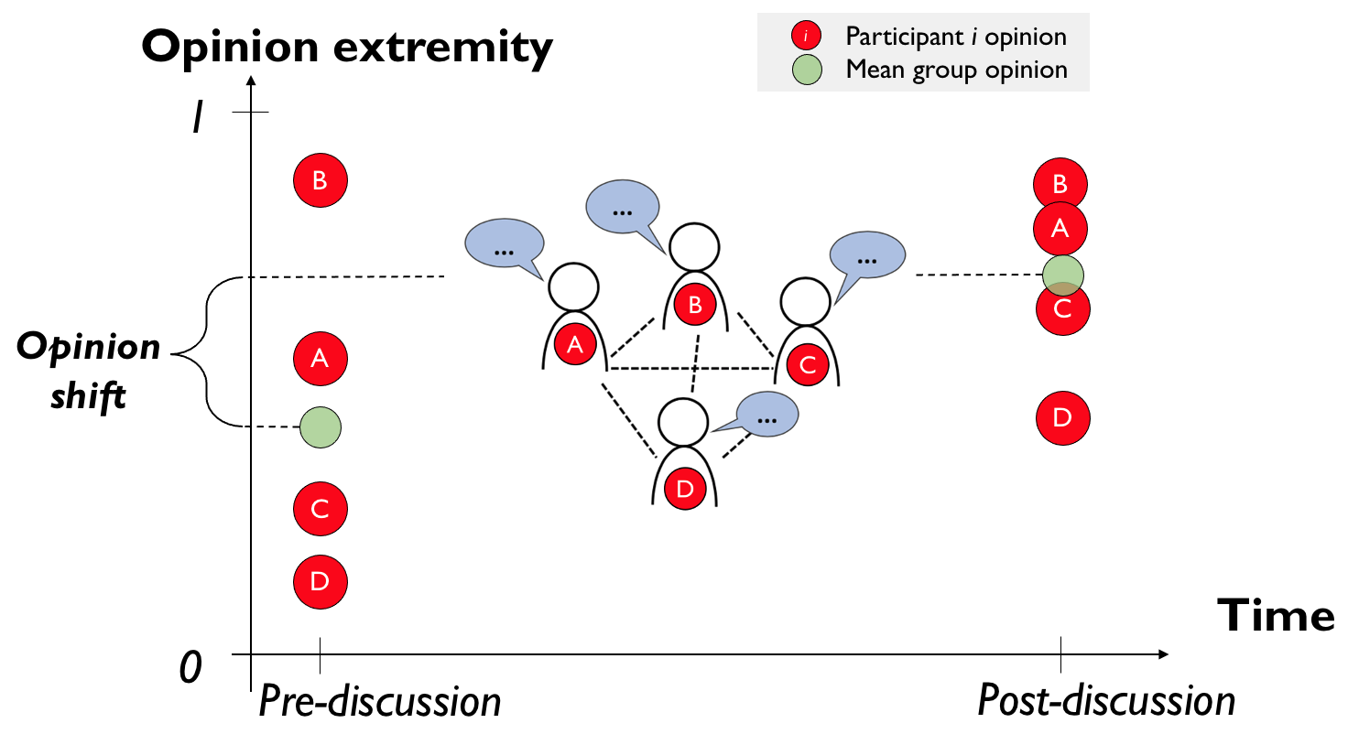
Simulating social influence dynamics
Create a group of simulated participants (“agents”) with opinions drawn from a normal distribution centered at one of several evenly-spaced initial mean group opinions.
Allow the participants to influence one another for several rounds of social influence under computational implementations of the assumptions of cognitive factors reviewed previously.
Assume simulated participants perfectly communicate their opinions numerically.
Agents are either attracted or repulsed in dyads depending on distance in “opinion space”. → Most influence will be attractive in this case.
Measure the post-discussion mean opinion. → The absolute difference between post-discussion and pre-discussion mean group opinion is the group polarization opinion shift.
Need to somehow explain how we go from the
cognitive factors listed in quad figure above to getting
the simulated data presented in the next slide, and in
results from Study 4.

Slide 43
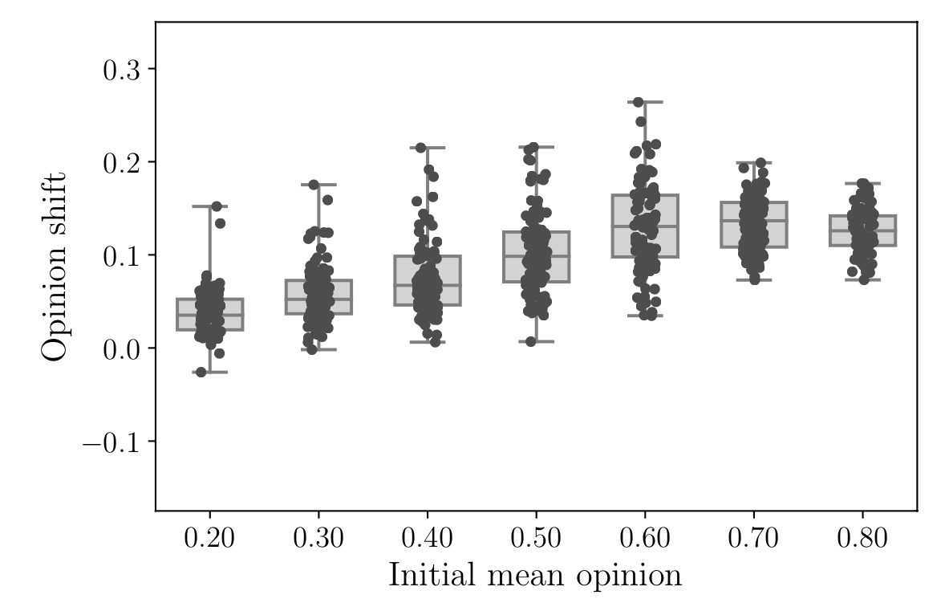
Group polarization patterns emerge from stubborn extremism
Figure: Simulated group polarization opinion shifts increase with initial mean opinion over many initial opinion settings. Each dot is the opinion shift from a single simulated group discussion. Grey boxes indicate middle 50% of data.
Notes:
Dashed line at zero

Slide 44
Study 2 Conclusion: Stubborn extremism is a more parsimonious explanation of group polarization than existing theories. Existing theories make overly complicated or problematic assumptions.

Slide 45
Study 3 Is group polarization real? Why many findings of group polarization are consistent with simple, not extreme, consensus.

Slide 46
To understand the problem, we need to understand some concepts in more detail:
The difference between latent psychological opinions and opinions reported as part of an experiment on an ordinal (e.g. Likert) scale.
The difference between “simple consensus” (variance decreases, mean unchanged) and group polarization “extremity-shifted” consensus (variance decreases, mean increases).
The difference between latent and ordinal opinion distributions.

Slide 47
“Latent” psychological opinions often reported as ordinal numerical ratings.
Latent psychological opinion
Measured opinion
I disagree this much:
-1.25

Slide 48
What if extreme consensus is an illusion due to floor and ceiling effects induced by ordinal measurement?
I agree
this much:
10,000.75
Pre-discussion
I agree
this much:
3.75
Post-discussion
Notes:
What I show in this Study is that many prominent group polarization results are consistent with simple consensus. This is equivalent to the null hypothesis that there is in fact no shift to extremity in group means.

Slide 49
Two important opinion distribution concepts:
Simple consensus vs. extremity-shifted consensus
Latent vs. ordinal opinion distributions

Slide 50
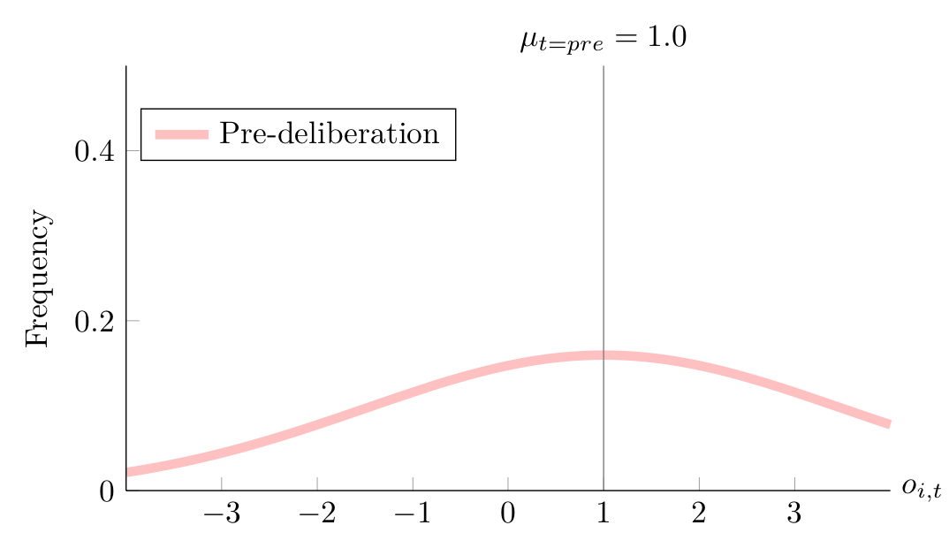
Simple consensus vs. extremity-shifted consensus
Pre-deliberation latent opinion distribution
Opinion
Notes:
Make plots in Latex with same colorscheme as the other ones within

Slide 51
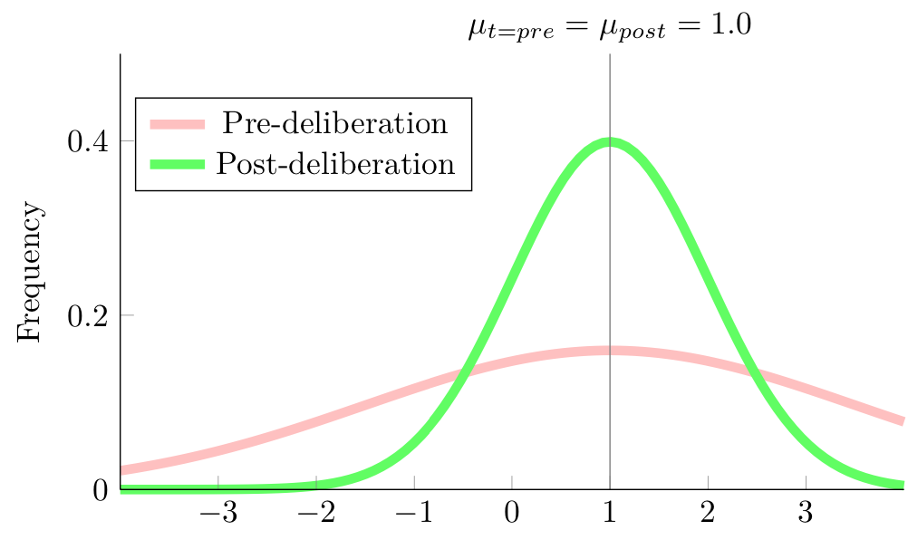
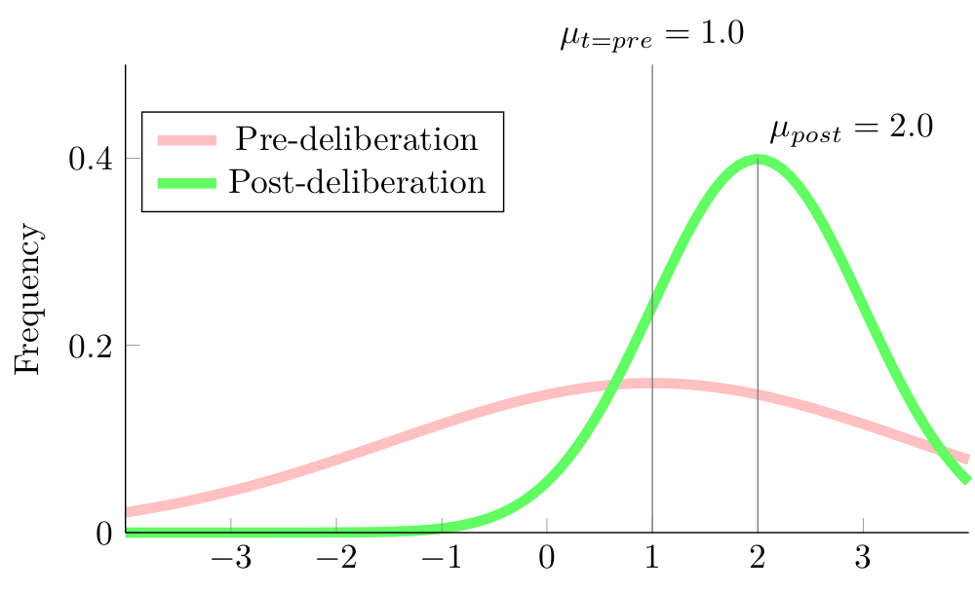
Simple consensus vs. extremity-shifted consensus
Simple consensus
Extremity-shifted consensus
Opinion
Opinion
Notes:
Make plots in Latex with same colorscheme as the other ones within

Slide 52
Latent (continuous) vs. measured (ordinal) distributions
Pre-deliberation latent opinion distribution
Opinion

Slide 53
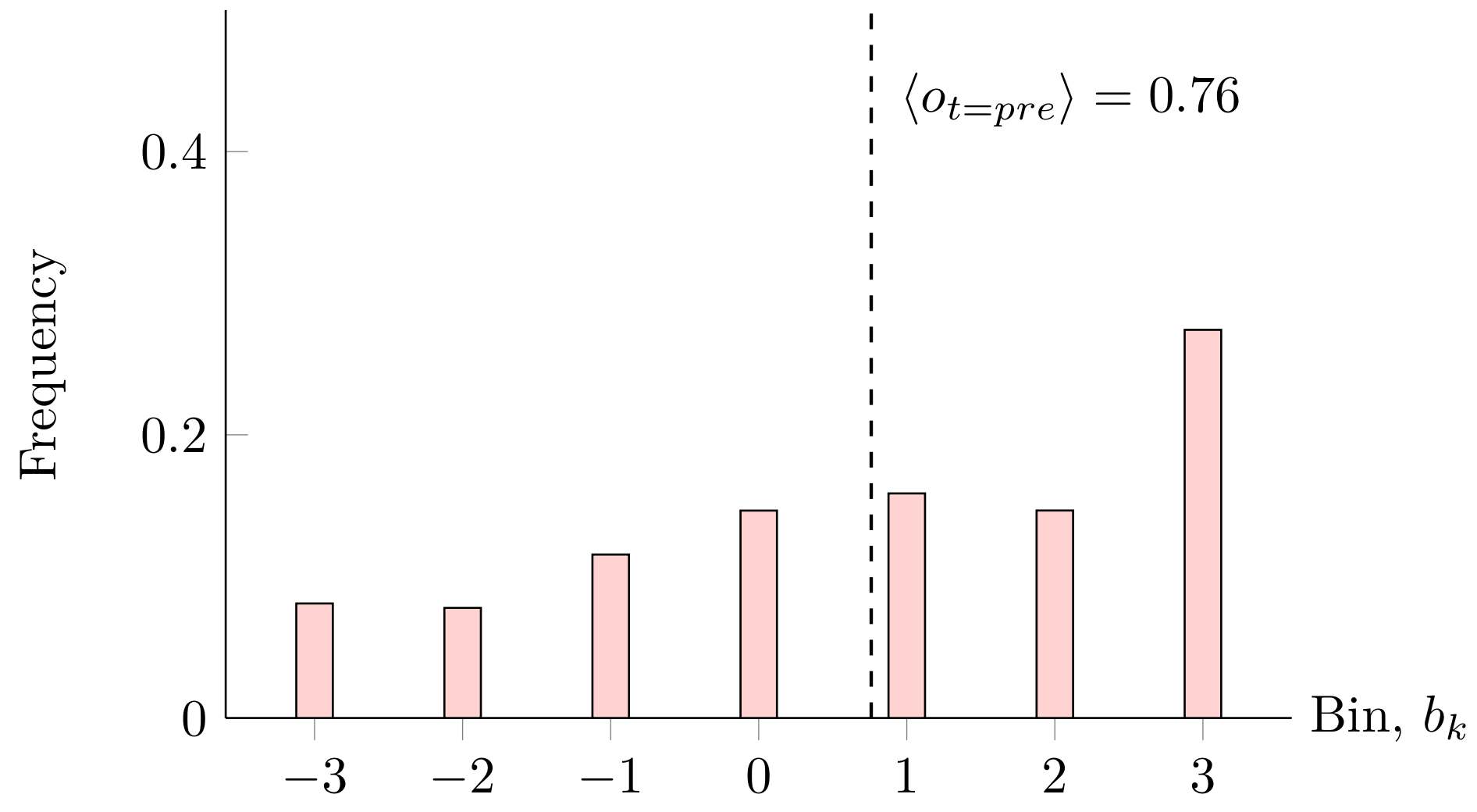
Latent (continuous) vs. measured (ordinal) distributions
Pre-deliberation latent distribution
Pre-deliberation measured distribution
Measured mean < latent mean
Ordinal
measurements
Opinion
Extreme latent opinions “stack up” at measurement scale extremes.

Slide 54
How simple consensus can look like extremity-shifted consensus.
Latent pre- and post-deliberation opinion distribution
Reported pre- and post-deliberation opinion distributions
Ordinal
measurements

Slide 55
How I determined whether results are consistent or not with simple consensus.
1. Given: pre-deliberation and post-deliberation means for each experimental condition, which is a potential false detection (FD).
2. Inverse problem: Can we find a constant latent mean and pre- and post-deliberation variances that, under simulated measurements, generate the observed shifts?
3. Check that observed variances are reasonable. If the variance is too high this implies (bi-)polarized distributions, which is not group polarization.

Slide 56
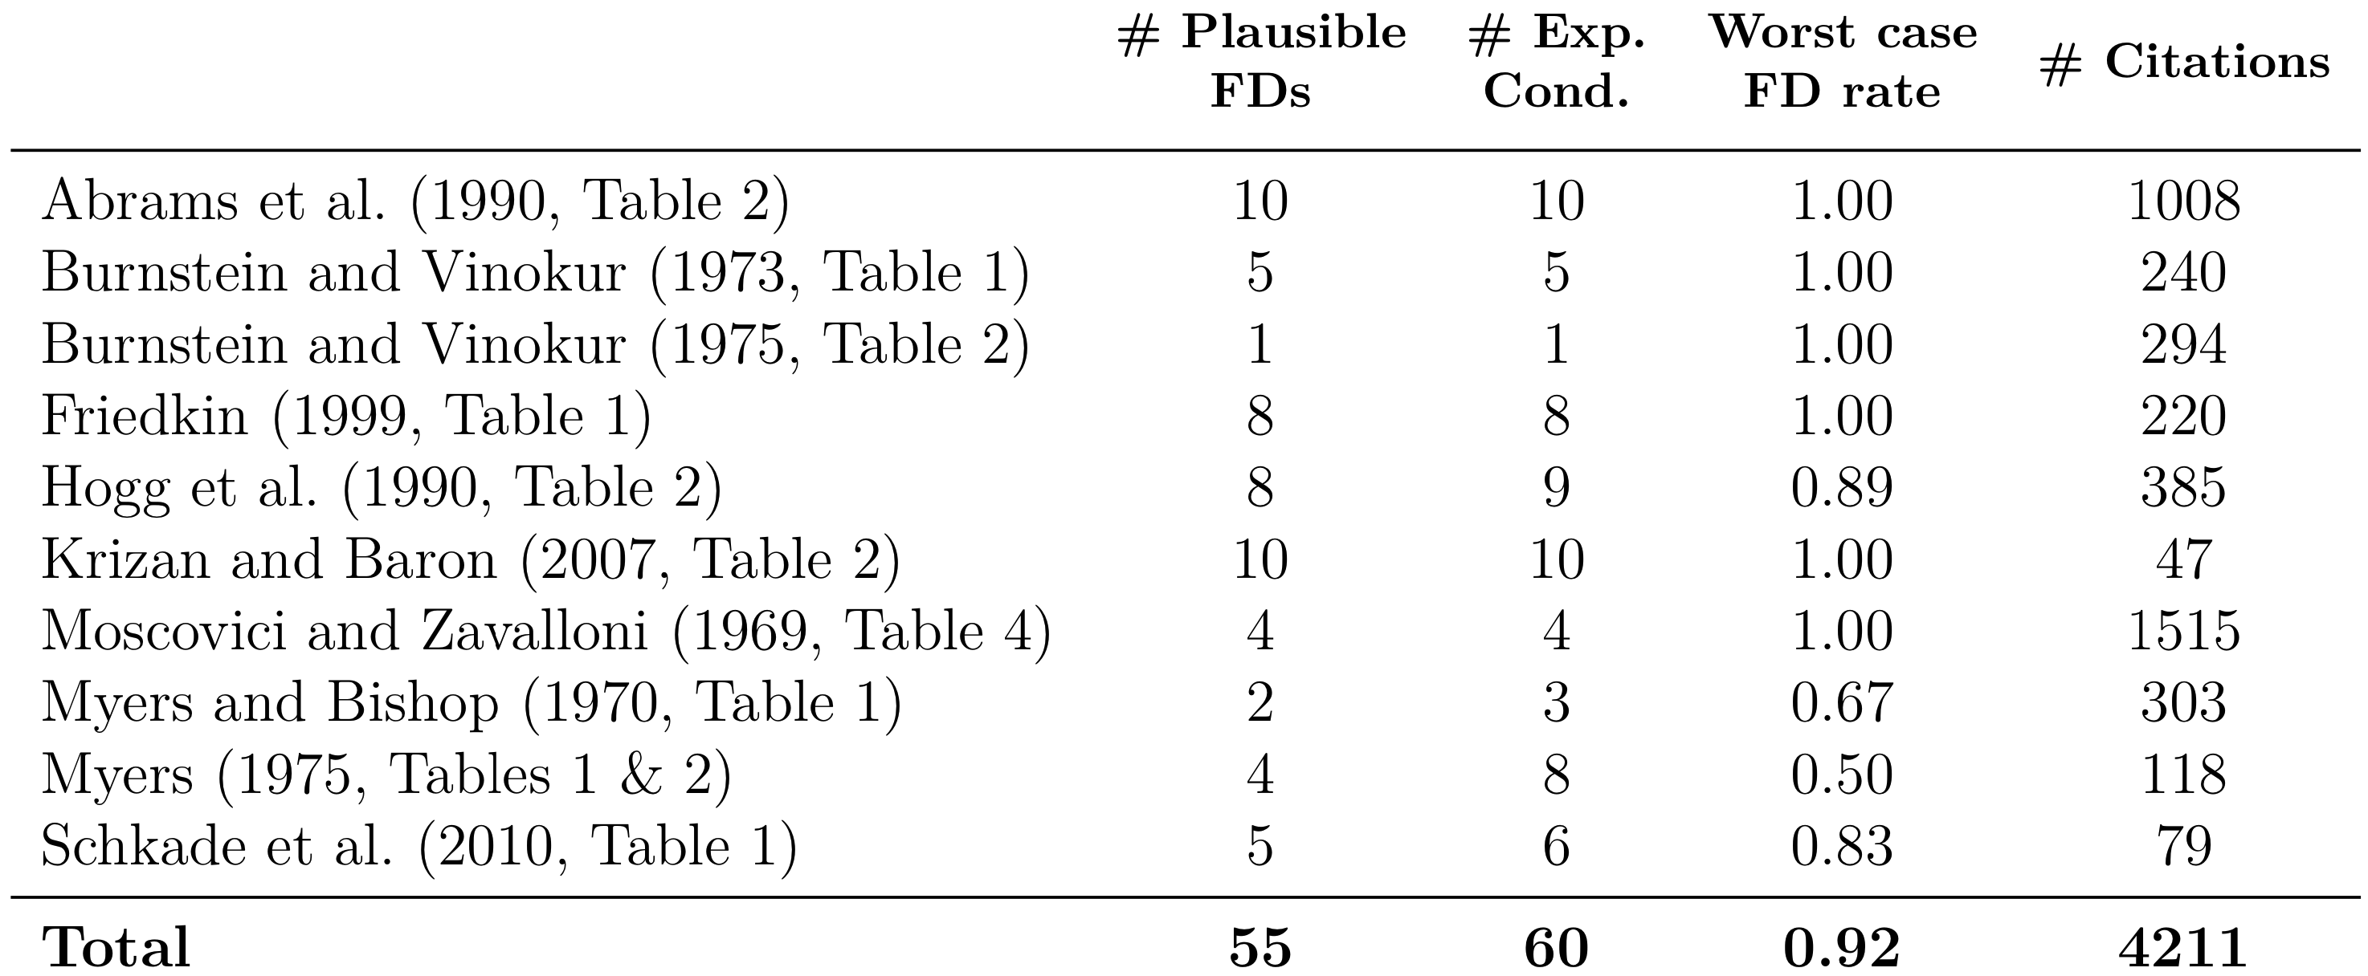
92% of selected studies are consistent with simple consensus.
# of experimental conditions
where group polarization is expected
# plausible FDs /
# expected GP detections
# of experimental results consistent with simple consensus

Slide 57
Study 3 Conclusion: I used a generative model of consensus to show many group polarization results are consistent with simple consensus. Without original data we cannot know if inferences are valid, i.e., if group polarization is real.

Slide 58
Study 4 Effects of random chance, extremism, and “cultural affordances” on polarization.

Slide 59


What social factors affect polarization outcomes?
1. Social networks that structure social influence
“Connected caveman network” where groups are often not exposed to one another.
Small-world networks emerge when random
out-group members become connected.
Flache, A., & Macy, M. W. (2011). Small Worlds and Cultural Polarization. The Journal of Mathematical Sociology, 35(1–3), 146–176.
Notes:
Here can say something like “we often represent social interaction patterns or affordances as a social network where nodes (circles here) represent people and the edges (lines between circles) represent the possibility of social influence between people.” The internet has vastly expanded the possibilities for social influence, including with out-groups who may have opposing viewpoints.

Slide 60

What social factors affect polarization outcomes?
2. Cultural complexity = # of cultural “affordances”/dimensions = K
Culture provides cognitive tools for communication and cognition.
Cultural complexity = 1
Cultural complexity > 1
Falandays, J. Ben, & Smaldino, P. E. (2021). The Emergence of Cultural Attractors: An Agent-Based Model of Collective Cognitive Alignment. In Proceedings of the Cognitive Science Society 2021.

Slide 61

Social influence model with K = 2 cultural affordances
Opinions are represented as coordinates in K-dimensional cartesian space.

Slide 62

Social influence model with K = 2 cultural affordances
Step 1: A population of agents (simulated participants) are initialized with random opinions.

Slide 63
Cognitive capacities and properties for social influence
1. Consensus and conformity
2. Repulsive influence
3. Stubborn extremism
4. Preference for similar others
Susceptibility to social influence
Moderate
Extremist
Notes:
Stubborn extremism is bolded because I demonstrate that this assumption, when included in a computational model of social influence, leads to the emergence of a phenomenon known as group polarization. Group polarization is the name given to the experimental observation that socially isolated groups tend to become more extreme over time, which I will explain in more detail later.

Slide 64


Social influence model with K = 2 cultural affordances
Step 2: Agents influence one another depending on whether they like or dislike each other.
Similar opinions attract.
Dissimilar opinions repulse.

Slide 65

Social influence model with K = 2 cultural affordances
Step 3: Social networks structure agent interactions that occur repeatedly over many timesteps.
N = 100

Slide 66

Polarization with K = 2 cultural affordances

Slide 67

Polarization with K = 2 cultural affordances

Slide 68

Polarization with K = 2 cultural affordances

Slide 69

Higher cultural complexity and lower connectivity reduces polarization.
Cultural complexity
Flache, A., & Macy, M. W. (2011). Small Worlds and Cultural Polarization. The Journal of Mathematical Sociology, 35(1–3), 146–176.
Notes:
Flache and Macy only reported the average results for populations that were maximally extreme to begin with, and they also assumed communication was perfect. This leads me to the following three questions that consider other social factors that could affect polarization.

Slide 70


Is polarization inevitable given initial conditions?
What other social factors may affect polarization?
3. Random chance
Notes:
Here can say something like “we often represent social interaction patterns or affordances as a social network where nodes (circles here) represent people and the edges (lines between circles) represent the possibility of social influence between people.” The internet has vastly expanded the possibilities for social influence, including with out-groups who may have opposing viewpoints.

Slide 71
Is polarization inevitable given initial conditions?
What other social factors may affect polarization?
4. Initial extremism
Notes:
Here can say something like “we often represent social interaction patterns or affordances as a social network where nodes (circles here) represent people and the edges (lines between circles) represent the possibility of social influence between people.” The internet has vastly expanded the possibilities for social influence, including with out-groups who may have opposing viewpoints.

Slide 72


Is polarization inevitable given initial conditions?
What other social factors may affect polarization?
5. Communication noise
Notes:
Here can say something like “we often represent social interaction patterns or affordances as a social network where nodes (circles here) represent people and the edges (lines between circles) represent the possibility of social influence between people.” The internet has vastly expanded the possibilities for social influence, including with out-groups who may have opposing viewpoints.

Slide 73
Random chance makes polarization difficult to predict.
Computational experimental procedure:
I simulated 100 model runs of social interaction processes all with the same initial opinions and social network.
The only thing that varied was the order in which agents interacted with one another.

Slide 74

Random chance makes polarization difficult to predict.
Each “whisker” along the x-axis indicates the polarization in a single outcome.
Solid lines are estimations of the probability density function of polarization outcomes.

Slide 75

Limiting extremism often reduces polarization.

Slide 76

Limiting extremism often reduces polarization.

Slide 77

Communication noise often leads to polarization.
Sketch:
You say: “I only like to eat tacos sometimes”
I hear: “I only like to eat tacos”

Slide 78

Communication noise often leads to polarization.

Slide 79
Study 4 Conclusion: I extended a model of polarization to understand the effects of random chance, initial extremism, and miscommunication on polarization outcomes. Polarization is highly path-dependent but can be reduced through lower initial extremism and lower miscommunication.

Slide 80
Conclusion
Question: What can we learn about how the complex dynamical system of social influence works to generate extremism and polarization. Specifically, what are some communicative, cognitive, and social factors at work in rising extremism and polarization?
Study 1: Metaphorical violence more correlated with debates, elections, candidate Twitter in 2016 than 2012.
Study 2: Stubborn extremism may be a more parsimonious explanation of group polarization than existing ones.
Study 3: I proved many existing group polarization findings are unreliable. Others using same methods may be too.
Study 4: Polarization is hard to predict, but low extremism squashes it, communication noise guarantees it.
Future work:
Other places where metaphorical violence is used, especially in dog whistle political language?
Do we really see stubborn extremism at work in group polarization experiments? I.e., is there an inverse correlation between opinion extremity and the amount individuals shift?
Are any group polarization studies fully reliable? Maybe continuous measured opinions, but existing studies doing this may be inflating significance due to ignoring multi-level variance.

Slide 81
Four studies of communicative, cognitive, and social factors in extremism and polarization
Matthew A. Turner
PhD Dissertation Defense
August 2, 2021
Chair: Paul E. Smaldino
Committee members: Teenie Matlock, Christopher T. Kello, and Jeffrey Yoshimi

Slide 82
Other acknowledgements:
My parents
MODSOC group and the Kello lab
Big Fridge! (come see us September 4th at the Partisan)
All my CIS student colleagues who made this enjoyable and challenged me to be better through their examples
All the CIS faculty who make this program a reality

Slide 83
THANK YOU FOR YOUR TIME AND ATTENTION TODAY!

Slide 84


Conclusion: commit to transcending partisanship
https://www.discovermagazine.com/mind/your-brain-on-politics-the-cognitive-neuroscience-of-liberals-and-conservatives
https://www.youtube.com/watch?v=kI-un8rHP14&t=414s
https://www.scientificamerican.com/article/conservative-and-liberal-brains-might-have-some-real-differences/

Slide 85

Social factors in rising extremism and polarization
1. Social networks structure social influence
?
or
2. Random chance
3. Cultural affordances
Notes:
Here can say something like “we often represent social interaction patterns or affordances as a social network where nodes (circles here) represent people and the edges (lines between circles) represent the possibility of social influence between people.” The internet has vastly expanded the possibilities for social influence, including with out-groups who may have opposing viewpoints.

Slide 86
Metaphorical violence on cable news

Slide 87

Group polarization experimental setup
A
A
B
B
A
B
C
C
C
D
D
D
Notes:
Need to harmonize agent indices.

Slide 88
Group polarization
Figure: Schematic of a single experimental trial
Participant i opinion
Mean group opinion
Opinion extremity
i
1
B
B
A
C
Opinion shift
A
D
C
D
Time
0
Pre-discussion
Post-discussion
Notes:
Could widen this figure and in the middle have deliberation figure from previous; move before results

Slide 89
Group polarization experimental setup
A
A
B
B
A
B
C
C
C
D
D
D
Notes:
Need to harmonize agent indices.

Slide 90
Dedicated to Phoebe Ruth “Oh, but why??”

